Slide 1



并行程序设计
任课教师：
卢宇彤（Lu, Yutong）
黄聃（Huang，Dan）

Slide 2
Summit
Summit: CPU+GPU
异构超算体系结构及使用示例
Based on Summit User Guide and
the slides of 2020 OLCF User Meeting
(Summit New User Training)

Slide 3
Agenda
Summit overview
Summit Scheduler and Job Launch Introduction
  Batch System (LSF)
  Job Launcher (jsrun)
The Summit Programming Environment
  LMOD Environment Modules
  Programming Models (MPI/OpenMP/CUDA)
Summit Burst Buffer
NVIDIA Profilers on Summit

Slide 4
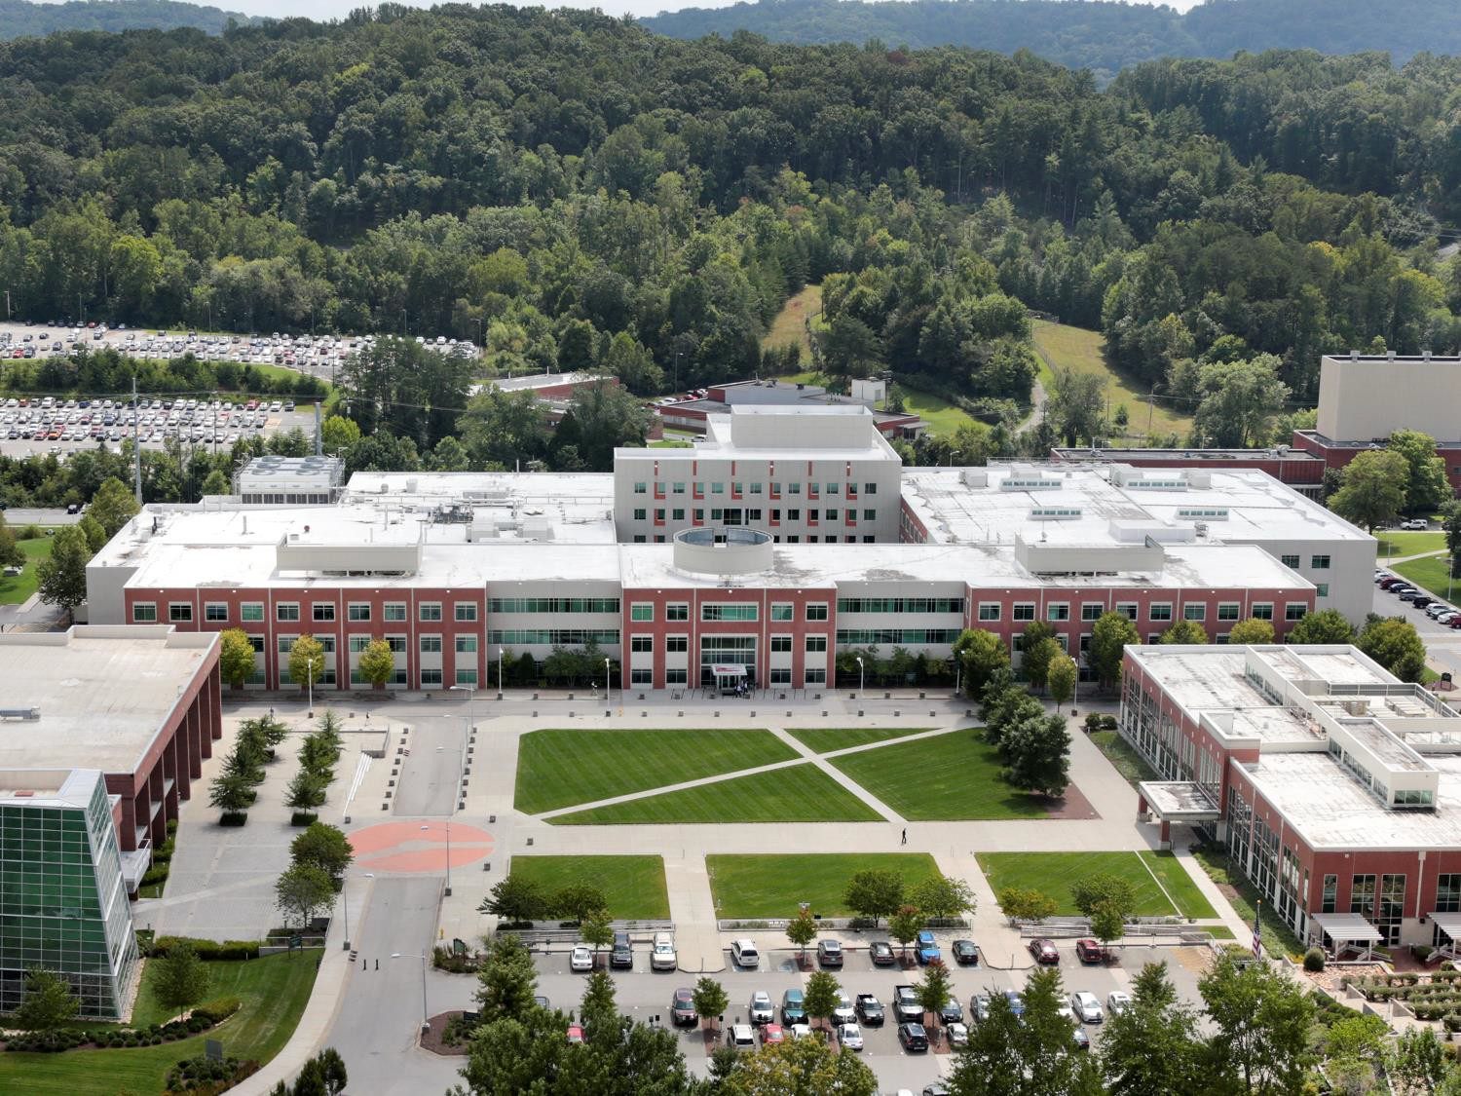
美国橡树岭国家实验室
Oak Ridge National Laboratory
Summit here
Frontier here

Slide 5







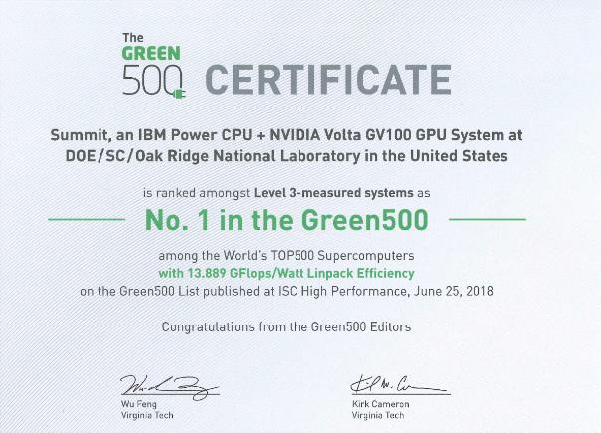





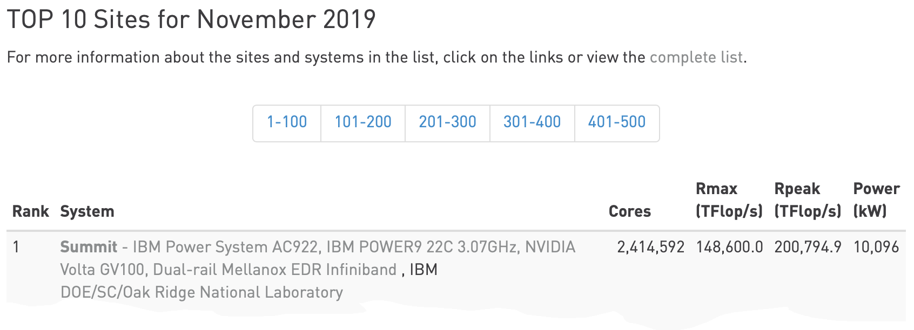

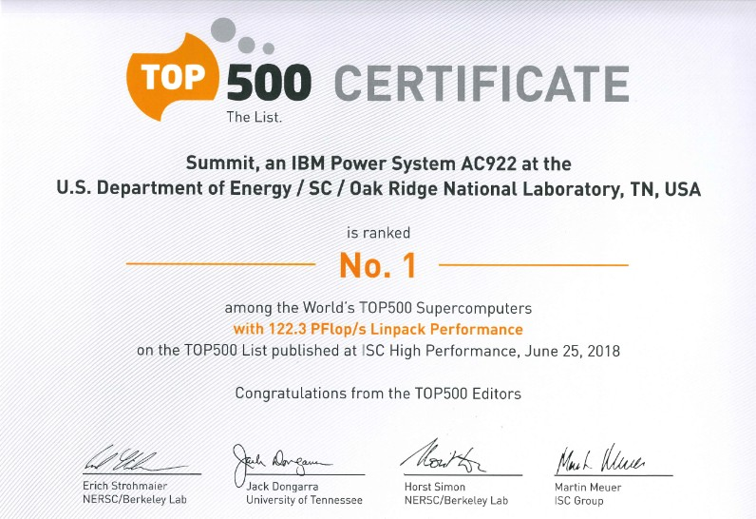

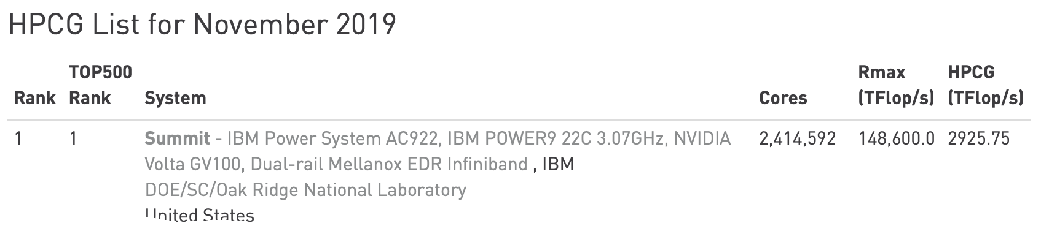
OLCF Summit Overview
Oak Ridge Leadership Computing Facility (OLCF)
The system includes
4,608 nodes
Dual-port Mellanox EDR InfiniBand network
250 PB IBM file system transferring data at 2.5 TB/s
System Performance
Peak of 200 Petaflops (FP₆₄) for modeling & simulation
Peak of 3.3 ExaOps (FP₁₆) for data analytics and artificial intelligence
Each node has
2 IBM POWER9 processors
6 NVIDIA Tesla V100 GPUs
608 GB of fast memory (96 GB HBM2 + 512 GB DDR4)
1.6 TB of NVRAM

Slide 6
Summit Considerations
Running Jobs
  Summit uses LSF for the batch queue system
  Summit uses jsrun as its parallel launcher
    Different approach to thinking about resources
Processor Architecture
  POWER9™
  Not compatible with x86_64 binaries, so you may have issues with precompiled software (LOTS of stuff targets x86_64)

Slide 7
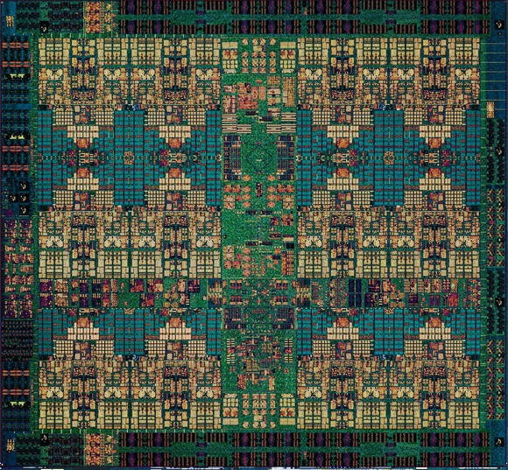
IBM Power9 Processor
Summit’s P9s: 22 cores (4 hw threads/core)
PCI-Express 4.0
  Twice as fast as PCIe 3.0
NVLink 2.0
  Coherent, high-bandwidth links to GPUs
14nm FinFET SOI technology
  8 billion transistors
Cache
  L1I: 32 KiB (per core, 8-way set associative)
  L1D: 32 KiB (per core, 8-way)
  L2: 512 KiB (per pair of cores)
  L3: 120 MiB eDRAM, 20-way (shared by all cores)

Slide 8
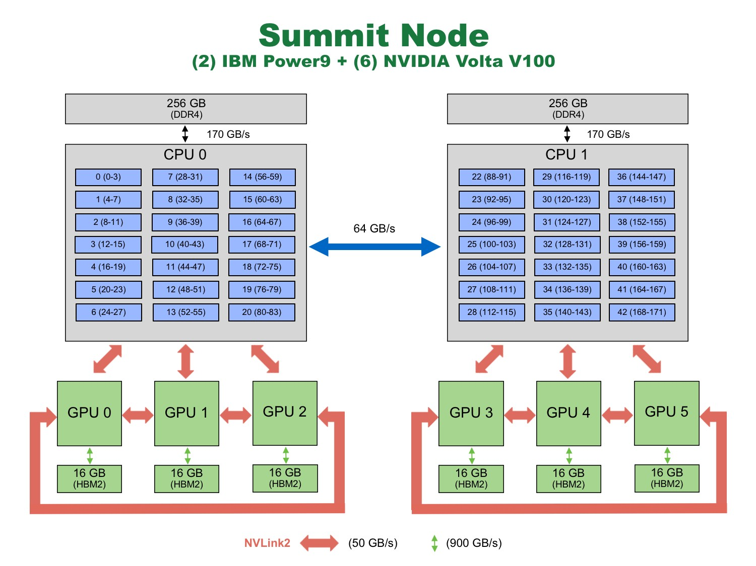

Slide 9
Power9 Processor Hardware Threads
Each cores has 4 “slices” which provide Simultaneous Multi Threading (SMT), similar to Hyper-Threading(HT) on some Intel microprocessors.
The four slices share the physical core’s L1 instruction & data caches.
Three SMT modes
SMT4 mode: each of the slices operates independently of the other three.
This would permit four separate streams of execution (i.e. OpenMP threads or MPI tasks) on each physical core. (Intel's Hyper-Threading does not have SMT4 mode)
SMT2 mode: pairs of slices work together to run tasks.
SMT1 mode: the four slices work together to execute the task/thread assigned to the physical core.

Slide 10
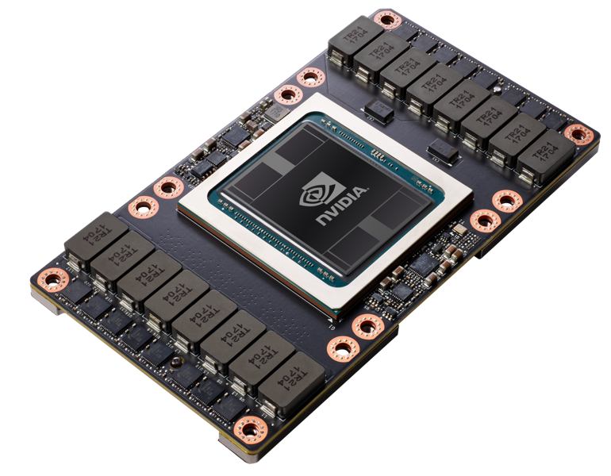
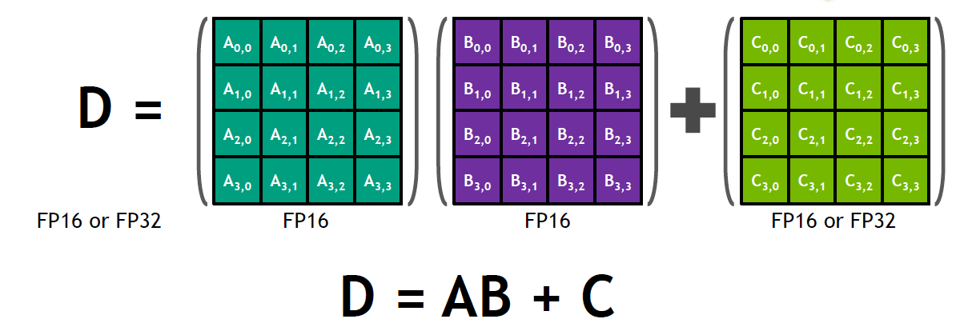
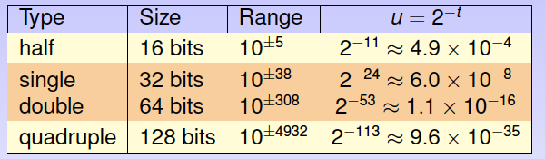
NVIDIA Tesla v100
Summit Contains 27,648 NVIDIA Tesla v100s
Each Tesla v100 GPU has:
150+150 GB/s total BW (NVLink v2.0)
5,120 CUDA cores (64 on each of 80 SMs)
640 Tensor cores (8 on each of 80 SMs)
20MB Registers | 16MB Cache | 16GB HBM2 @ 900 GB/s
7.5 DP TFLOPS | 15 SP TFLOPS | 120 FP₁₆ TOPS
Tensor cores do mixed precision multiply-add of 4x4 matrices

Slide 11
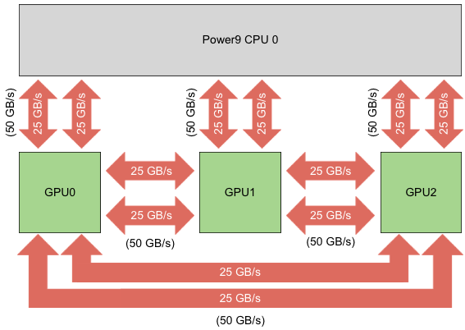
NVIDIA NVLink
The processors(CPU&GPU) within a node are connected by NVIDIA’s NVLink interconnect
Each link has a peak bandwidth of 25 GB/s (in each direction), so
2 links between processors
bandwidth: 25 x 2 = 50 GB/s.
bi-directional bandwidth:
bandwidth: 50 x 2 = 100 GB/s.

Slide 12


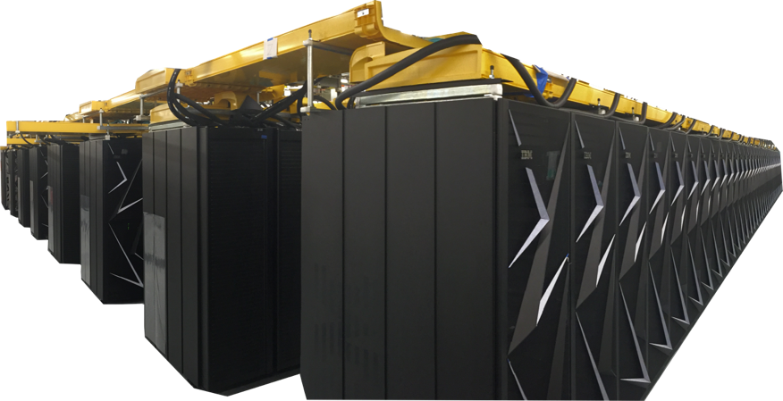
Summit Specs
Feature | Summit
Peak FLOPS | 200 PF
Max possible Power | 13 MW
Number of Nodes | 4,608
Node performance | 42 TF
Memory per Node | 512 GB DDR4 + 96 GB HBM2
NV memory per Node | 1.6 TB
Total System Memory | 2.8 PB + 7.4 PB NVM
System Interconnect | Dual Port EDR-IB (25 GB/s)
Interconnect Topology | Non-blocking Fat Tree
Bi-Section Bandwidth | 115.2 TB/s
Processors on node | 2 IBM POWER9™ 6 NVIDIA Volta™
File System | 250 PB, 2.5 TB/s, GPFS™

Slide 13
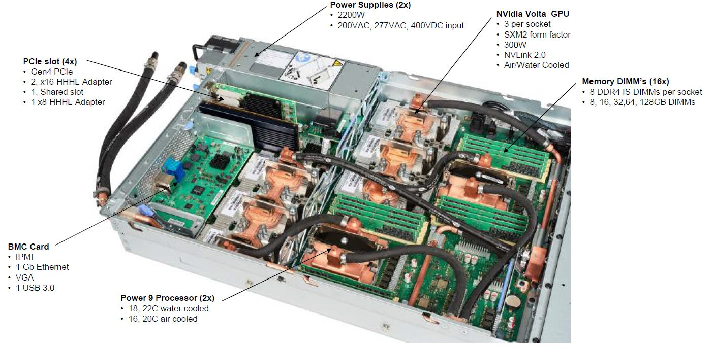
Summit Board (1 node) showing the Water Cooling

Slide 14
Agenda
Summit overview
Summit Scheduler and Job Launch Introduction
  Batch System (LSF)
  Job Launcher (jsrun)
The Summit Programming Environment
  LMOD Environment Modules
  Programming Models (MPI/OpenMP/CUDA)
Summit Burst Buffer
NVIDIA Profilers on Summit

Slide 15
Summit Node Types
Node Type | Description
Login | When connecting to Summit, you are placed on a login node Write, edit, and compile code, manage data, and submit jobs Not to launch parallel jobs or run threaded jobs
Launch (Batch) | When batch script starts running, it will execute on a Launch NodeAll commands within your job script will run on a launch node Avoid running multiprocessor/threaded programs on launch nodes and instead launch the jsrun command from there.
Compute | Most of the nodes on Summit are compute nodes Where your parallel job executes Accessed via the jsrun command.

Slide 16
Summit Node Types
Logically organized into different types
But contain similar hardware
Node Type | CPU | GPU
Login | 2 x 16-core Power9 CPUs | 4 x V100 GPUs
Compute | 2 x 22-core Power9 CPUs | 6 x V100 GPUs
Called Homogeneous architecture
Not a need to cross-compile when building on a login node

Slide 17
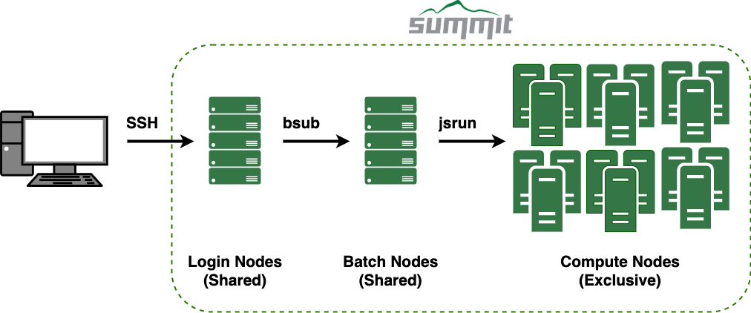
Summit Scheduler and Job Launch

Slide 18
Summit Scheduler and Job Launch

Slide 19
Summit Scheduler and Job Launch

Slide 20
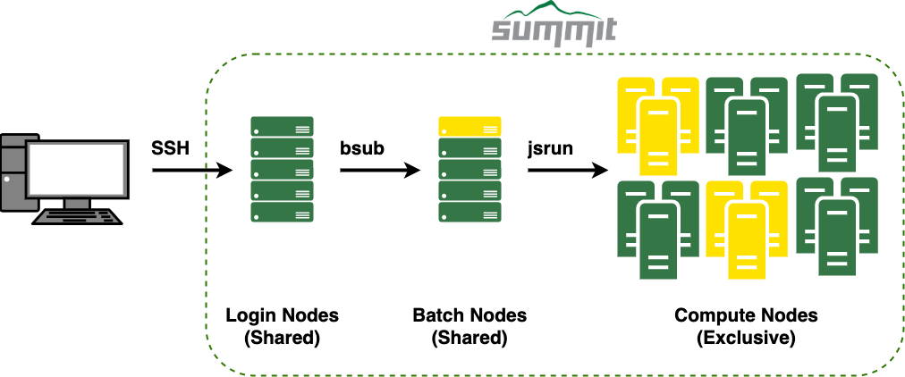


Summit Parallel Job Execution
Batch System (LSF)
Job Launcher (jsrun)
Batch scheduler, allocates resources
Similar functionality to PBS/MOAB/SLURM
Allocates entire nodes
Developed by IBM for the Oak Ridge and Livermore CORAL systems
Similar functionality to aprun/srun/mpirun

Slide 21
Agenda
Summit overview
Summit Scheduler and Job Launch Introduction
  Batch System (LSF)
  Job Launcher (jsrun)
The Summit Programming Environment
  LMOD Environment Modules
  Programming Models (MPI/OpenMP/CUDA)
Summit Burst Buffer
NVIDIA Profilers on Summit

Slide 22




LSF Example Batch Script
Batch script example
2-hour walltime 2 nodes ABC007 project
Output file example.o<jobid> Job name
#!/bin/bash
#BSUB -W 2:00
#BSUB -nnodes 2 #BSUB -P abc007
#BSUB -o example.o%J #BSUB -J example
hostname
jsrun -n2 -r1 -a1 -c1 hostname
Batch node (batch2) Compute node (h23n01)
Batch submission
bsub example.lsf
Job <29209> is submitted to default queue <batch>.

Slide 23







LSF Interactive Batch Job
Allows access to compute resources interactively
Through batch system similar to batch script submission, but returns prompt on launch node
Run multiple jsrun with only one queue wait, very useful for testing and debugging
Syntax
  Use –Is and the shell to be started
  Most other batch flags valid
  Add batch flags to command line
Presentation examples use the following to allocate resources
bsub -Is -P abc007 –nnodes 2 –W 2:00 $SHELL Job <29507> is submitted to default queue <batch>.
<<Waiting for dispatch ...>>
<<Starting on batch1>>
hostname
batch1
jsrun -n2 -r1 hostname
a01n01 a01n02

Slide 24
Common LSF Commands
Function | PBS/MOAB | SLURM | LSF
Submit | qsub | sbatch/salloc | bsub
Monitor Queue | showq/qstat | squeue | bjobs/jobstat
Investigate Job | checkjob | scontrol/sacct | bhist
Alter Queued Job | qalter | scontrol update | bmod
Remove Queued Job | qdel | scancel | bkill
Hold Queued Job | qhold | scontrol hold | bstop
Release Held Job | qrls | scontrol release | bresume

Slide 25
Viewing the Batch Queue with jobstat
OLCF developed tool to help view queue
summit-login1 1082> jobstat
--------------------------- Running Jobs: 7 (4158 of 4608 nodes, 90.23%) ---------------------------
JobId Username Project Nodes Remain
StartTime 512 44:22 11/30 11:01:25
272 11/30 11:52:15
1 11/30 11:23:50
3200 11/30 12:16:43
2 11/30 11:46:32
170 11/30 11:48:09
11/30 12:09:29
JobName run745-A3 run745-B2 Not_Specified Not_Specified Not_Specified 20_a_1
Job3
221070 userA
221090 userA
221092 userB
221105 userC
221095 userD
221088 userE
221097 userF
CSC100 CSC100 CSC006 CSC007 CSC201
Default Job Name
1:35:12
1:06:47
2:59:40
1:29:29
1:31:06
CSC100 CSC100
1 1:52:26
Eligible Jobs: 2
JobId Username 221108 userC
221101 userC
Project CSC007 CSC007
Nodes Walltime 4200 10:00:00
1048 6:00:00
QueueTime 11/30 12:16:07
11/30 12:12:28
Priority JobName
520.00 Not_Specified
515.00 Not_Specified
Running job limit reached
Blocked Jobs: 4
JobId Username 221099 userA
221110 userC
221107 userC
221151 userC
Project CSC100 CSC007 CSC007 CSC007
Nodes Walltime 1048 6:00:00
BlockReason
JOBS limit defined for the user or user group has been reach JOBS_PER_SCHED_CYCLE defined for the user or user JOBS_PER_SCHED_CYCLE defined for the user or user JOBS_PER_SCHED_CYCLE defined for the user or user
1800 8:00:00
1 45:00
16 3:00:00
Eligible job limit reached

Slide 26
Agenda
Summit overview
Summit Scheduler and Job Launch Introduction
  Batch System (LSF)
  Job Launcher (jsrun)
The Summit Programming Environment
  LMOD Environment Modules
  Programming Models (MPI/OpenMP/CUDA)
Summit Burst Buffer
NVIDIA Profilers on Summit

Slide 27
jsrun Introduction
Launch job on compute resources
Similar functionality to srun and mpirun
Launch nodes
– Non-jsrun commands executed on launch node

Slide 28
Resource Set Introduction
jsrun format:
jsrun [ -n #Resource Sets ] [tasks, threads, and GPUs w/in each Resource Set] program
Resource set
  Subgroup of resources within a node
    GPUs, CPUs
  Just cgroups under the covers
  Building blocks of jsrun
  Provides the ability to create subsets of nodes
    Flexibility to add resources based on code’s requirements
  Limitations
    Can span sockets; can not span nodes
    Entire cores; not hyper-thread level
    Homogeneous by default

Slide 29
Choosing a Resource Set
Understand how your code expects to interact with the system.
  How many tasks/threads per GPU?
  Does each task expect to see a single GPU? Do multiple tasks expect to share a GPU? Is the code written to internally manage task to GPU workload based on the number of available cores and GPUs?
Create resource sets containing the needed GPU to task binding
  Based on how your code expects to interact with the system, you can create resource sets containing the needed GPU and core resources.
  If a code expects to utilize one GPU per task, a resource set would contain one core and one GPU. If a code expects to pass work to a single GPU from two tasks, a resource set would contain two cores and one GPU.
Decide on the number of resource sets needed
  Once you understand tasks, threads, and GPUs in a resource set, you simply need to decide the number of resource sets needed.

Slide 30
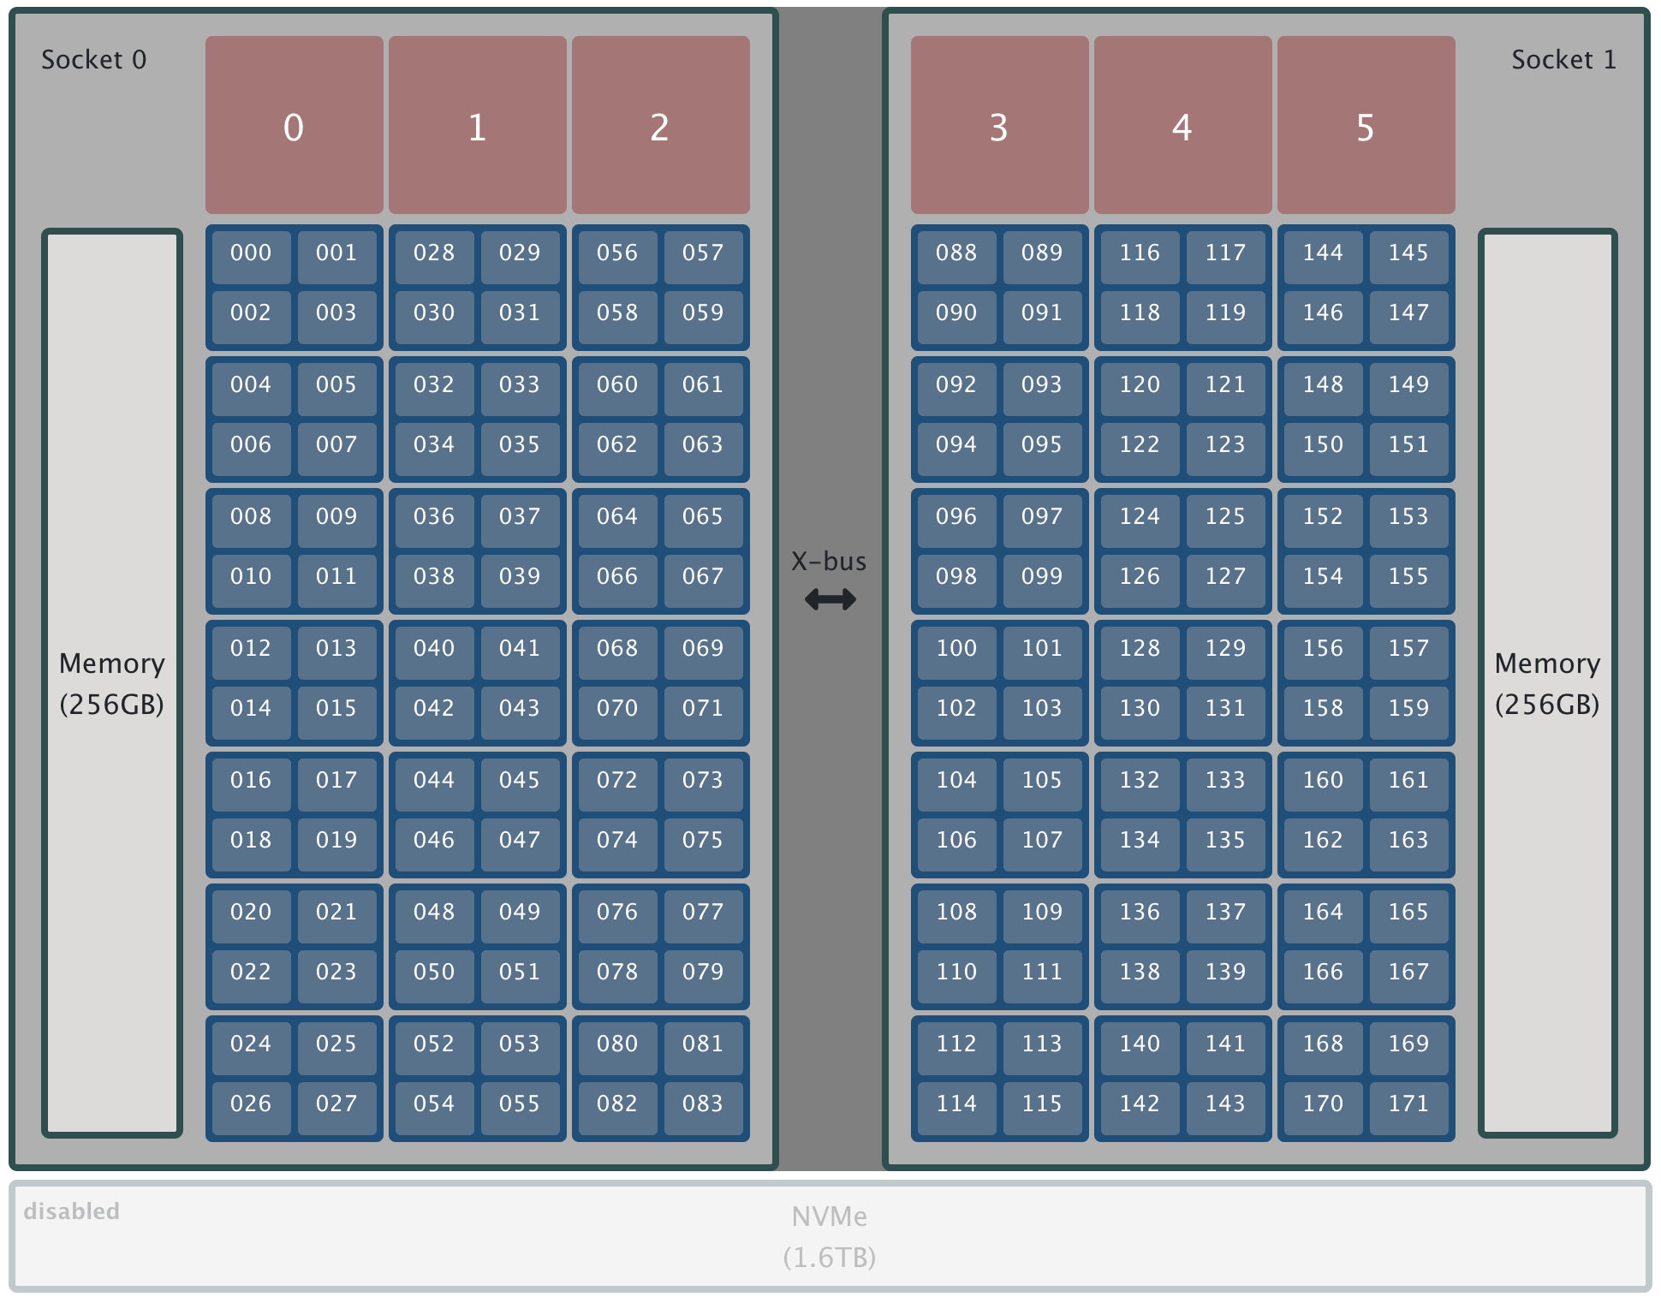
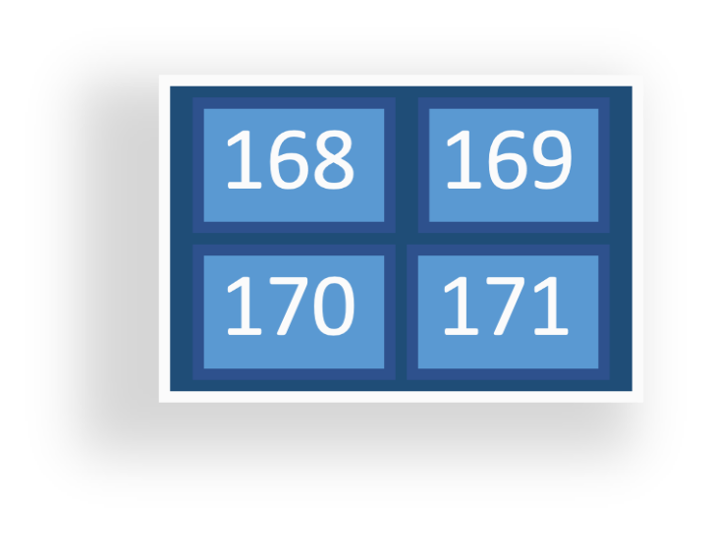



Summit Node
GPU
(3 x Socket)
Core
(21 x Socket)
Socket
(2 x Node)
*Core Isolation:
1 core on each socket has been set aside for overhead and is not available for allocation through jsrun.
The core has been omitted and is not shown in the image.
Hardware Thread
( 4x Core)
RAM
*Numbering skips due to core isolation

Slide 31
Hardware Thread Levels
Each physical core contains 4 hardware threads
Simultaneous Multithreading (SMT)
Power9 supports 3 levels: 1, 2, or 4 virtual cores
SMT level set for each batch job
  #BSUB –alloc_flags smt1
  #BSUB –alloc_flags smt2
  #BSUB –alloc_flags smt4 (default)
jsrun controls task/thread layout

Slide 32
Jsrun Format and Options
jsrun [ -n #Resource Sets ] [tasks, threads, and GPUs w/in each Resource Set] program
Flags (long) | Flags (short) | Description
--nrs | -n | Number of resource sets
--rs_per_host | -r | Number of resource sets per host (node)
--tasks_per_rs | -a | Number of MPI tasks/ranks per resource set
--cpu_per_rs | -c | Number of CPUs (cores) per resource set.
--gpu_per_rs | -g | Number of GPUs per resource set
--bind | -b | Binding of tasks within a resource set. Can be none, rs, or packed:#
--latency priority | -l | Latency Priority. Controls layout priorities. Can currently be cpu-cpu or gpu-cpu. Upper v/s lower case.
--launch_distribution | -d | How tasks are distributed between resource sets. Can be cyclic, packed, plane.

Slide 33
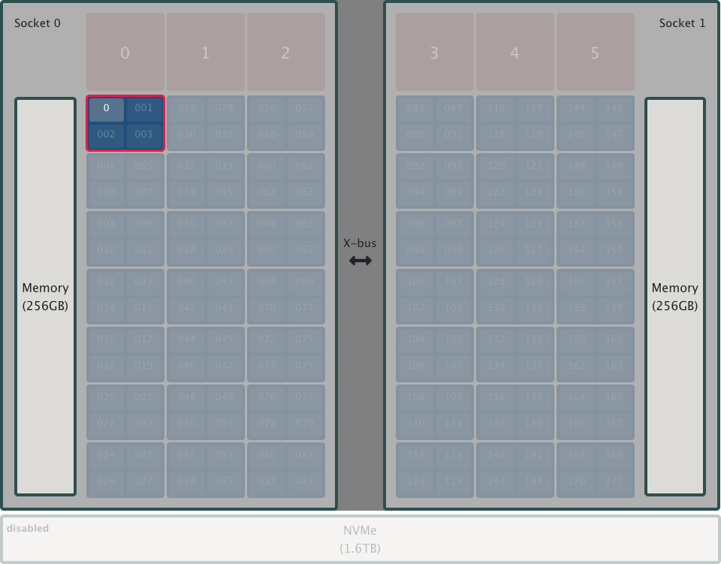
jsrun examples
jsrun –n1 a.out
1
resource set
What do you get by default?
– Almost nothing

Slide 34
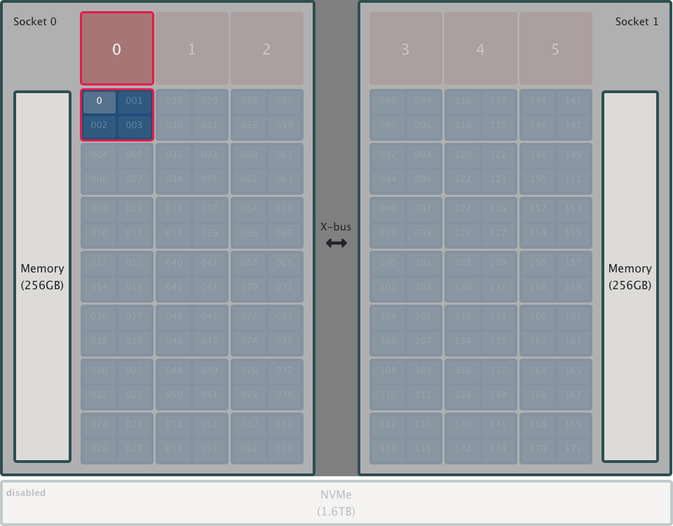

jsrun examples
jsrun –n1 –a1 –c1 –g1
1
resource set
x
1
task
1
physical core
1
GPU
Explicitly requesting resources is to your benefit.
– Don’t rely on defaults.
How many of these resource sets can we fit on a single node?

Slide 35
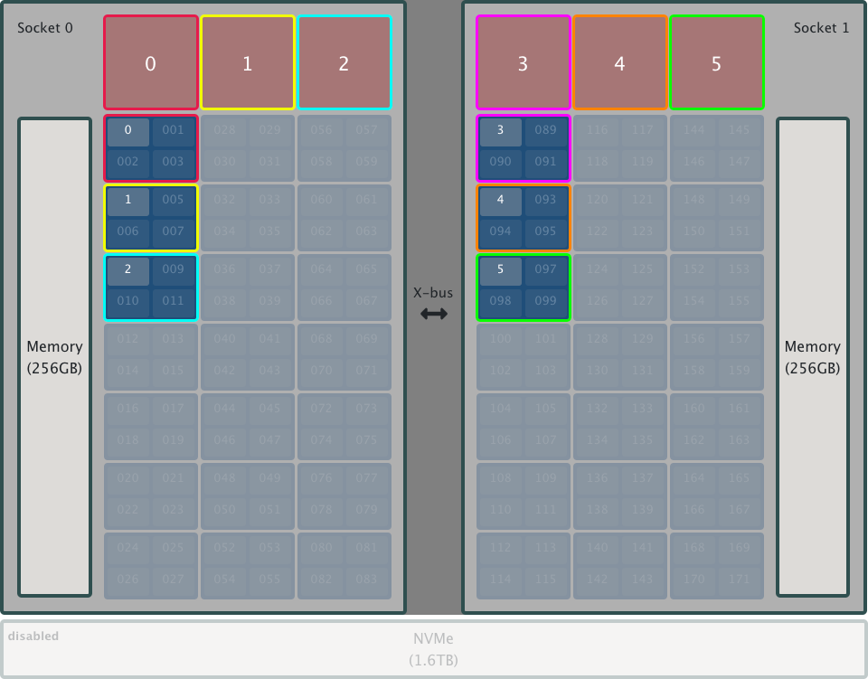
jsrun examples
jsrun –n6 –a1 –c1 –g1
6
resource sets
1
task
1
physical core
1
GPU
x
Increase the number of RS
Each RS will contain same number of specified tasks, cores, GPUs

Slide 36
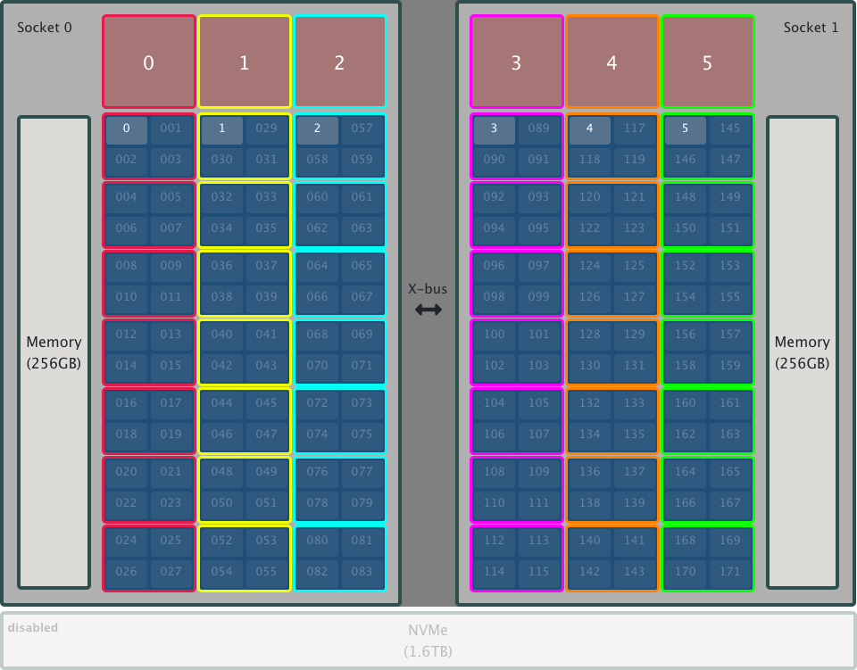
jsrun examples
jsrun –n6 –a1 –c7 –g1
6
resource sets
x
1
task
7
physical cores
1
GPU
Increase cores per RS to utilize all available physical cores.
Still only one task per RS

Slide 37
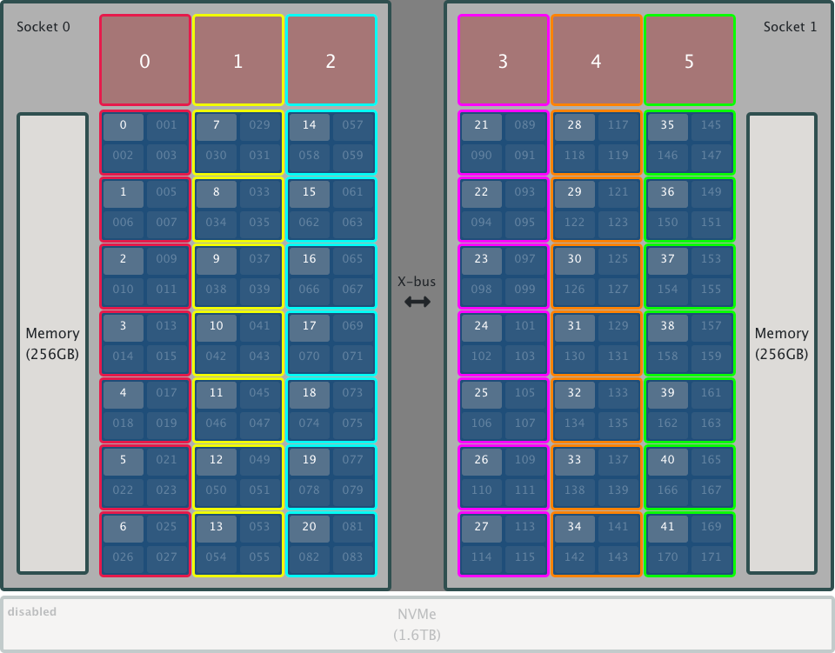

jsrun examples
jsrun –n6 –a7 –c7 –g1 -dpacked
6
resource sets
x
7
tasks
7
physical cores
1
GPU
assign tasks sequentially filling RS first
Launch distribution controls the order of tasks started across multiple resource sets

Slide 38
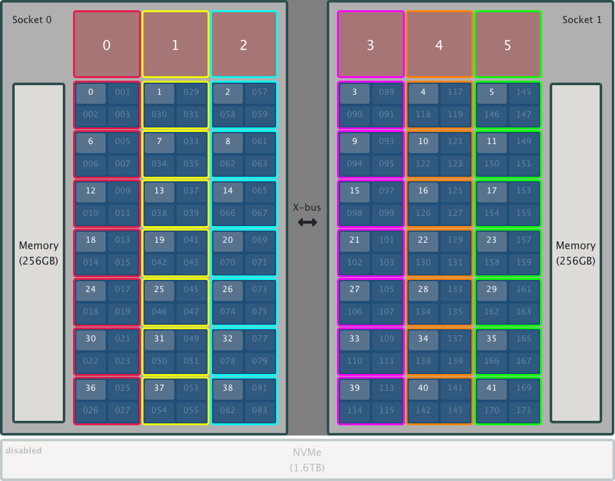
jsrun examples
jsrun –n6 –a7 –c7 –g1 -dcyclic
6
resource sets
x
7
tasks
7
physical cores
1
GPU
assign tasks round robin across RS
Change the order of tasks started across multiple resource sets to round robin

Slide 39

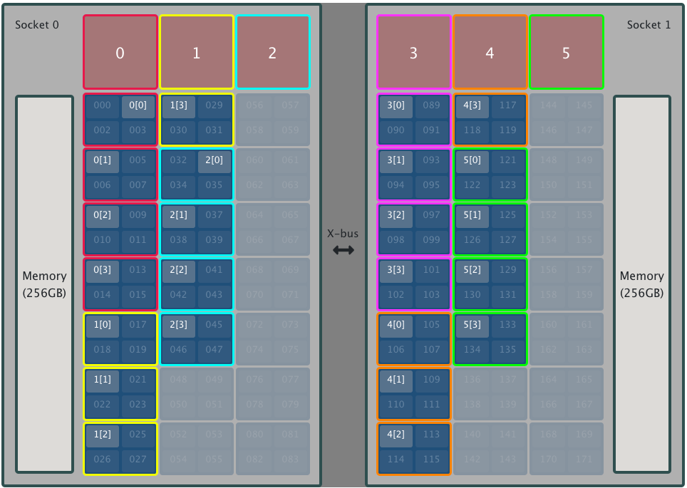
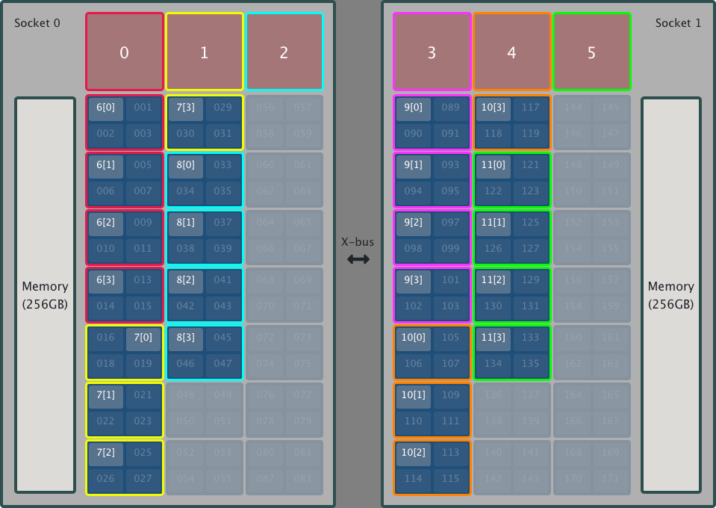
jsrun examples (threads)
jsrun –n12 –a1 –c4 –g1 –b packed:4 –d packed
# 2-node allocation
# OMP_NUM_THREADS = 4
# rank0’s OMP_PLACES = {0:4},{4:4},{8:4},{12:4}
1
task
4
physical cores
1
GPU
bind tasks to 4 cores in resource set
assign tasks sequentially filling RS first
12
resource sets
x

Slide 40
jsrun Binding Flag
Options:
  none
    No binding
  rs
    Bind to cores in resource set
    Not Recommended
  packed:#
    Default: packed:1
    Number of CPUs bound to task
  packed:smt:#
    Hardware threads bound to task
-b, --bind
Binding of tasks within a resource set
OMP_PLACES, affinity
Should specify binding to help prevent unwanted oversubscription
summit-batch1> jsrun –n1 -a1 –c2 ./jsrun_layout | sort
MPI Rank 000 of 001 on HWThread 000 of Node h41n08, OMP_threadID 0 of 2
MPI Rank 000 of 001 on HWThread 000 of Node h41n08, OMP_threadID 1 of 2
Threads placed on same core with default binding.
summit-batch1> jsrun –n1 -a1 –c2 -bpacked:2 ./jsrun_layout | sort
MPI Rank 000 of 001 on HWThread 000 of Node h41n08, OMP_threadID 0 of 2
MPI Rank 000 of 001 on HWThread 004 of Node h41n08, OMP_threadID 1 of 2
Use ‘–b packed:2’ to bind each rank to 2 cores.

Slide 41
Viewing jsrun Layout
Execute code within interactive batch job to view jsrun layout
Lab maintained example code:
– https://docs.olcf.ornl.gov/systems/summit_user_guide.html#hello-jsrun
summit-batch1> jsrun –n2 -a2 –d cyclic ./jsrun_layout | sort
... Warning: more than 1 task/rank assigned to a core
MPI Rank 000 of 004 on HWThread 000 of Node h41n08, OMP_threadID 0 of 1
MPI Rank 001 of 004 on HWThread 004 of Node h41n08, OMP_threadID 0 of 1
MPI Rank 002 of 004 on HWThread 000 of Node h41n08, OMP_threadID 0 of 1
MPI Rank 003 of 004 on HWThread 004 of Node h41n08, OMP_threadID 0 of 1
Without –c multiple ranks are placed on single core.
Adding cores to RS provides a core for each rank.
summit-batch1> jsrun –n2 -a2 –c2 -d cyclic ./jsrun_layout | sort
MPI Rank 000 of 004 on HWThread 000 of Node h41n08, OMP_threadID 0 of 1
MPI Rank 001 of 004 on HWThread 008 of Node h41n08, OMP_threadID 0 of 1
MPI Rank 002 of 004 on HWThread 004 of Node h41n08, OMP_threadID 0 of 1
MPI Rank 003 of 004 on HWThread 012 of Node h41n08, OMP_threadID 0 of 1
Notice default rank placement order cycles between RS.
summit-batch1> jsrun –n2 -a2 –c2 –d packed ./jsrun_layout | sort
MPI Rank 000 of 004 on HWThread 000 of Node h41n08, OMP_threadID 0 of 1
MPI Rank 001 of 004 on HWThread 004 of Node h41n08, OMP_threadID 0 of 1
MPI Rank 002 of 004 on HWThread 008 of Node h41n08, OMP_threadID 0 of 1
MPI Rank 003 of 004 on HWThread 012 of Node h41n08, OMP_threadID 0 of 1
Changing distribution order to packed changes RS rank placement.

Slide 42
Viewing jsrun Layout
js_task_info: binary provided by jsrun developers
Examples ran with default SMT4
Default binding to one physical core
summit-batch1> jsrun -n1 -a4 -c4 -bpacked:1 -dpacked js_task_info | sort
Task 0 ( 0/4, 0/4 ) is bound to cpu[s] 0-3 on host a01n18 with OMP_NUM_THREADS=1 and with OMP_PLACES={0:4}
Task 1 ( 1/4, 1/4 ) is bound to cpu[s] 4-7 on host a01n18 with OMP_NUM_THREADS=1 and with OMP_PLACES={4:4}
Task 2 ( 2/4, 2/4 ) is bound to cpu[s] 8-11 on host a01n18 with OMP_NUM_THREADS=1 and with OMP_PLACES={8:4}
Task 3 ( 3/4, 3/4 ) is bound to cpu[s] 12-15 on host a01n18 with OMP_NUM_THREADS=1 and with OMP_PLACES={12:4}
Binding packed:smt:4
summit-batch1> jsrun -n1 -a4 -c4 -bpacked:smt:4 -dpacked js_task_info | sort
Task 0 ( 0/4, 0/4 ) is bound to cpu[s] 0-3 on host a01n18 with OMP_NUM_THREADS=1 and with OMP_PLACES={0:4}
Task 1 ( 1/4, 1/4 ) is bound to cpu[s] 4-7 on host a01n18 with OMP_NUM_THREADS=1 and with OMP_PLACES={4:4}
Task 2 ( 2/4, 2/4 ) is bound to cpu[s] 8-11 on host a01n18 with OMP_NUM_THREADS=1 and with OMP_PLACES={8:4}
Task 3 ( 3/4, 3/4 ) is bound to cpu[s] 12-15 on host a01n18 with OMP_NUM_THREADS=1 and with OMP_PLACES={12:4}
summit-batch1> jsrun -n1 -a4 -c4 -bpacked:smt:1 -dpacked js_task_info | sort
Task 0 ( 0/4, 0/4 ) is bound to cpu[s] 0 on host a01n18 with OMP_NUM_THREADS=1 and with OMP_PLACES={0}
Task 1 ( 1/4, 1/4 ) is bound to cpu[s] 1 on host a01n18 with OMP_NUM_THREADS=1 and with OMP_PLACES={1}
Task 2 ( 2/4, 2/4 ) is bound to cpu[s] 2 on host a01n18 with OMP_NUM_THREADS=1 and with OMP_PLACES={2}
Task 3 ( 3/4, 3/4 ) is bound to cpu[s] 3 on host a01n18 with OMP_NUM_THREADS=1 and with OMP_PLACES={3}
Binding packed:smt:1
All tasked placed on single physical core

Slide 43
Viewing jsrun Layout
Execute tools on compute nodes through jsrun
summit-batch3> jsrun -n1 -g0 sh -c 'nvidia-smi --query-gpu=gpu_name,gpu_bus_id --format=csv' No devices were found
No visible GPUs
summit-batch3> jsrun -n1 -g3 sh -c 'nvidia-smi --query-gpu=gpu_name,gpu_bus_id --format=csv' name, pci.bus_id
Tesla V100-SXM2-16GB, 00000004:04:00.0
Tesla V100-SXM2-16GB, 00000004:05:00.0
Tesla V100-SXM2-16GB, 00000004:06:00.0
3 visible GPUs
summit-batch3> jsrun -n1 -g4 -c42 sh -c 'nvidia-smi --query-gpu=gpu_name,gpu_bus_id --format=csv' name, pci.bus_id
Tesla V100-SXM2-16GB, 00000004:04:00.0
Tesla V100-SXM2-16GB, 00000004:05:00.0
Tesla V100-SXM2-16GB, 00000035:03:00.0
Tesla V100-SXM2-16GB, 00000035:04:00.0
Bus ID shows two GPUs per socket visible

Slide 44

Multiple Jsruns Sequentially
Walltime should be long enough to run all jsruns and support tasks
#!/bin/bash
#BSUB -W 2:00
#BSUB -nnodes 2
#BSUB -P abc007
cd $MEMBERWORK/abc007
jsrun –n12 –r6 –g1 –a2 –c2 ./a.out fileA
jsrun –n1 –r1 –a12 –c12 ./post_process fileA fileB
jsrun –n12 –r6 –g1 –a2 –c2 ./a.out fileB
jsrun –n1 –r1 –a12 –c12 ./post_process fileB fileC
jsrun –n12 –r6 –g1 –a2 –c2 ./a.out fileC
Allocated nodes should be as large as largest jsrun
Nodes Required
Time Required
2
00:25:00
All tasks executed sequentially
jsrun post_process will not launch until the previous jsrun a.out completes
.1
00:05:00
2
00:30:00
.1
00:05:00
2
00:25:00
Simultaneous Nodes
2
Total Walltime
01:30:00

Slide 45

Multiple Jsruns Simultaneously
Walltime should be long enough to run longest running jsrun
#!/bin/bash
#BSUB -W 1:00
#BSUB -nnodes 6 #BSUB -P abc007
Allocated nodes should be as large as the sum of all simultaneous jsruns
cd $MEMBERWORK/abc007
Nodes Required
2
Time Required
00:25:00
jsrun –n12 –r6 –g1 –a2 –c2 ./a.out fileA &
Placing jsruns in background allows each to run at same time. Jsrun will place each on separate resources.
2
00:30:00
jsrun –n12 –r6 –g1 –a2 –c2 ./a.out fileB &
2
00:25:00
jsrun –n12 –r6 –g1 –a2 –c2 ./a.out fileC &
UNIX wait ensures script does not exit before backgrounded work completes.
Without wait, batch job will exit before jsruns are complete.
Simultaneous Nodes
6
Max Walltime
00:30:00
wait

Slide 46
Multiple Simultaneous Job Steps
jsrun placement managed by IBM’s CSM (Cluster System Management)
Aware of all jsrun allocations within LSF job; allows multiple per node, multi node, …
Following example ran on 2-node allocation
summit-batch3> jsrun -n1 -a1 -c1 -g6 -bpacked:1 csh -c "js_task_info; sleep 30" &
Task 0 ( 0/1, 0/1 ) is bound to cpu[s] 0-3 on host a01n02
All GPUs on node, 1 CPU
summit-batch3> jsrun -n1 -a1 -c42 -g0 -bpacked:1 csh -c "js_task_info; sleep 30" &
Requires all cores on node, placed on separate node
Task 0 ( 0/1, 0/1 ) is bound to cpu[s] 0-3 on host a01n01
summit-batch3> jsrun -n1 -a1 -c1 -g1 -bpacked:1 csh -c "js_task_info; sleep 30" &
Not enough free resources, waiting on completion of running step
summit-batch3 1023> jslist
parent cpus gpus exit
ID ID nrs per RS per RS status status
===============================================================================
17 | 0 | 1 | 1 | 6 | 0 | Running
18 | 0 | 1 | 42 | 0 | 0 | Running
19 | 0 | 1 | 1 | 1 | 0 | Queued
1 | 0 | 1 | 1 | 3 | 0 | Complete
jslist command displays job steps
Note: In a batch job, backgrounded tasks require wait command

Slide 47
Agenda
Summit overview
Summit Scheduler and Job Launch Introduction
  Batch System (LSF)
  Job Launcher (jsrun)
The Summit Programming Environment
  LMOD Environment Modules
  Programming Models (MPI/OpenMP/CUDA)
Summit Burst Buffer
NVIDIA Profilers on Summit

Slide 48
What is the Programming Environment?
Your Applications & Jobs
Resource & Workload Managers
Scalable Debuggers &
Analysis
Utilities
Performance Math & Parallel Libraries
Compiler Toolchains
Userland Tools
& Utilities
IO Service & Runtimes
Programming Model Runtimes
LLCA, Networks
Common Linux Runtime Libraries
Operating System
Hardware

Slide 49
Programming Environment Overview
At the highest level, the PE is your shell’s build- and run-time environment (see output of env).
Software outside default (/usr/bin, /usr/lib, etc.) UNIX paths.
Managed via session environment variables
  Search paths
    PATH, LD_LIBRARY_PATH, LIBRARY_PATH, PKG_CONFIG_PATH, etc…
  Program environment options
    OMPI_*, CC, FC, etc…
Summit uses LMOD for this purpose

Slide 50
Agenda
Summit overview
Summit Scheduler and Job Launch Introduction
  Batch System (LSF)
  Job Launcher (jsrun)
The Summit Programming Environment
  LMOD Environment Modules
  Programming Models (MPI/OpenMP/CUDA)
Summit Burst Buffer
NVIDIA Profilers on Summit

Slide 51
LMOD Environment Modules
Much of the available software cannot coexist simultaneously in your environment.
Build- and runtime-environment software managed with LMOD
(https://lmod.readthedocs.io)
Usage:
$ module -t list # list loaded modules
$ module avail # Show modules that can be loaded given current env
$ module help <package> # Help info for package (if provided)
$ module show <package> # Show contents of module
$ module load <package> <package>… # Add package(s) to environment
$ module unload <package> <package>… # Remove package(s) from environment
$ module reset # Restore system defaults
$ module restore <collection> # Load a saved collection
$ module spider <package> # Deep search for modules
$ module purge # Clear all modules from env.

Slide 52
Module Avail
The command shows
module avail
only what can be loaded given currently loaded packages.
Full or partial package names limit output to matches.
$ module avail
------------- /sw/summit/modulefiles/site/linux-rhel7-ppc64le/Core -------------
...
Path in MODULEPATH where a module exists. Printed in order of priority.
cuda/10.1.168 |  | py-nose/1.3.7 (D)
cuda/10.1.243 | (D) | py-pip/9.0.1
gcc/4.8.5 gcc/5.4.0 | (L) | python/3.5.2 readline/6.3
Where:
L: Module is loaded
D: Default Module
Future labels will have explanation in legend (shown on in non-terse output)
Use "module spider" to find all possible modules.
Use "module keyword key1 key2 ..." to search for all possible modules matching any of the "keys".

Slide 53
Modulefile Priority
Loading some modules will alter the MODULEPATH.
– Compilers, MPI: Only one module in families can be loaded at a time.
First module among duplicate package/version names in
MODULEPATH
will be selected:
$ module -t avail hdf5/1.10.4
/sw/summit/modulefiles/site/.../spectrum-mpi/10.3.1.2-20200121-p6nrnt6/xl/16.1.1-5: hdf5/1.10.4
/sw/summit/modulefiles/site/.../xl/16.1.1-5: hdf5/1.10.4
Example: MPI-enabled builds replace serial builds when MPI implementation is loaded.

Slide 54
Modulefile Priority
To override behavior, alter the MODULEPATH yourself:
$ module use /path/to/module/file/tree
$ module unuse /path/to/remove/from/search/tree
Path is prepended with higher priority
Can also provide your own custom modulefiles.
– Complete instructions for writing modulefiles: https://lmod.readthedocs.io/en/latest/015_writing_modules.html

Slide 55
Agenda
Summit overview
Summit Scheduler and Job Launch Introduction
  Batch System (LSF)
  Job Launcher (jsrun)
The Summit Programming Environment
  LMOD Environment Modules
  Programming Models (MPI/OpenMP/CUDA)
Summit Burst Buffer
NVIDIA Profilers on Summit

Slide 56




Compiler Environments
IBM XL (default)
GCC
PGI
xl/16.1.1-7
xl/16.1.1-6
xl/16.1.1-5 (default)
xl/16.1.1-4
– Older not recommended
gcc/9.1.0
gcc/8.1.1
gcc/7.4.0
pgi/20.1
pgi/19.10
pgi/19.9 (default)
pgi/18.10
pgi/18.7
Supports OMP-Offload and OpenACC
– Latest w/ CUDA10 NVCC
gcc/6.4.0 (default)
gcc/5.4.0
gcc/4.8.5
  RHEL7 OS compiler in `/usr`
  “Core” modulefiles
LLVM/Clang
llvm/9.0.0-2
llvm/1.0-20190225 (default)
– Older not recommended
New compiler releases added regularly.

Slide 57
MPI Implementation – IBM Spectrum-MPI
Based on OpenMPI, similar compiler wrappers and flags
mpicc, mpic++, mpiCC, mpifort, mpif77, mpif90,
mpixl*
Modules
spectrum-mpi/10.3.1.2-20200121
(default)
– Avoid hidden older releases
Updates usually require recompilation.
Uses MPI launcher (See separate talk in this series)
jsrun
Avoid Alt. implementations (OpenMPI)
–
openmpi/4.0.3
is experimental and not recommended for general use.

Slide 58
MPI vs OpenMP
MPI provides explicit communication between separate processes
  Optionally on separate nodes – ie packets over a network
  Most parallel development in last 2 decades has used this approach
OpenMP provides work-sharing and synchronization between threads in a single process
  Threads share the same memory image
  To make the most of a KNL node, most applications will need to use OpenMP

Slide 59
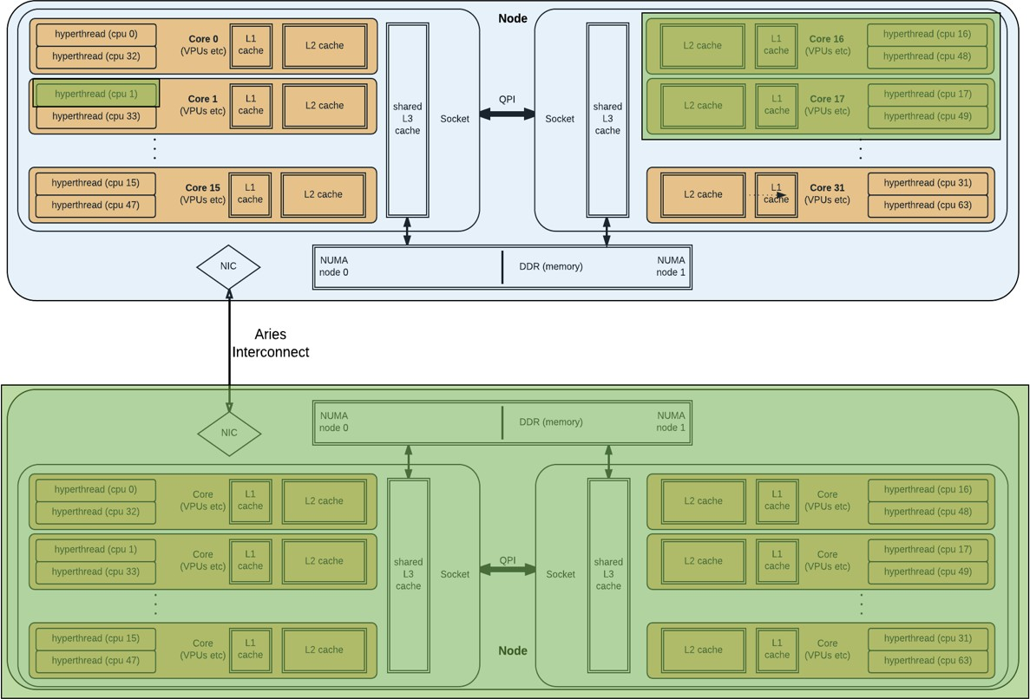
MPI vs OpenMP
An MPI application can have processes on more than one node
An OpenMP application exists entirely within 1 node
MPI rank 0
OpenMP thread 0
OpenMP thread 1
MPI rank 1

Slide 60
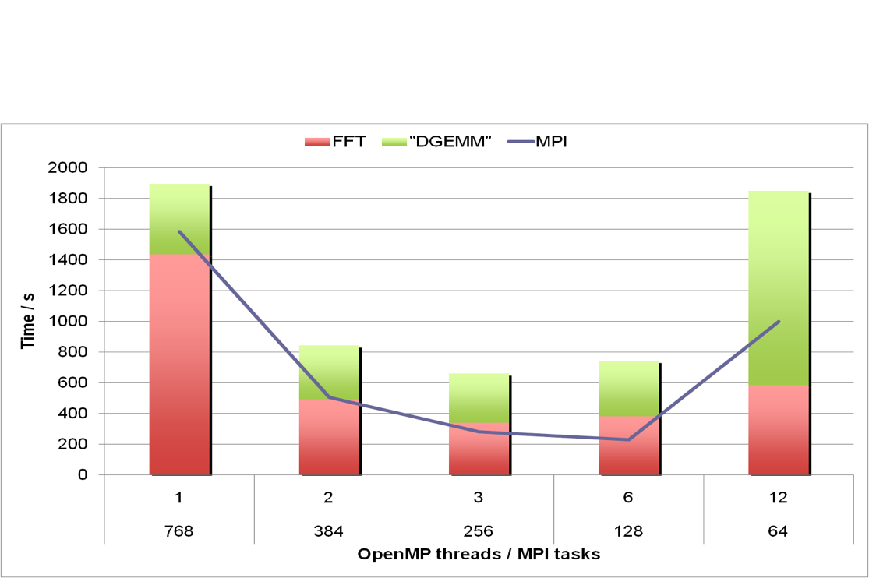
Why do we suddenly need OpenMP?
Multi-level parallelism
  At very large scale, the overheads of MPI (or any parallel approach) become excessively costly
  Combining (nesting) parallel approaches allows us to operate each at lower scale
    Sweet spot for best overall eﬃciency
  MPI -> OpenMP -> Vectorization

Slide 61
CUDA/NVCC
Module (default)
cuda/10.1.243
Available under all compiler environments
If you’re not using the GPUs, you’re not really using the machine
Provides cuBLAS, cuDNN
– cuBLAS located according to CUDA ≤ 9 scheme:
${OLCF_CUDA_ROOT}/{lib64,include}
Older modules available, but not recommended for use
– Recompile against latest version available if possible

Slide 62

CUDA Multi-Process Service (MPS)
Allows multiple processes (e.g., MPI ranks) to concurrently share the resources on a single GPU.
To enable, use LSF flag: –alloc_flags “gpumps”
$ jsrun -n1 -c4 -g1 -a4 -bpacked:1 ./vector_add
CUDA Error - vector_addition.cu:36: 'all CUDA-capable devices are busy or unavailable' CUDA Error - vector_addition.cu:36: 'all CUDA-capable devices are busy or unavailable' CUDA Error - vector_addition.cu:36: 'all CUDA-capable devices are busy or unavailable'
Without MPS, you might see errors like these
SUCCESS
N | = | 1048576
Threads Per Block | = | 256
Blocks In Grid | = | 4096
For more information, see the OLCF user documentation or NVIDIA’s more comprehensive document: https://docs.olcf.ornl.gov/systems/summit_user_guide.html#volta-multi-process-service https://docs.nvidia.com/deploy/pdf/CUDA_Multi_Process_Service_Overview.pdf

Slide 63
CUDA-Aware MPI
Allows GPU buffers (e.g., memory allocated with cudaMalloc) to be used directly in MPI calls, rather than needing to manually transfer data to/from a CPU buffer (e.g., using cudaMemcpy) before/after passing data in MPI calls.
To enable, use jsrun flag: --smpiargs=“-gpu”
COMMON POINT OF CONFUSION:
CUDA-Aware MPI is separate from GPUDirect!
By itself, CUDA-Aware MPI does not specify whether data is staged through CPU memory or transferred directly between GPUs.
GPUDirect is a technology that can be implemented on a system to enhance CUDA- Aware MPI by allowing data transfers directly between GPUs on the same node (peer-to-peer) and/or directly between GPUs on different nodes (with RDMA support) without the need to stage data through CPU memory. Both are implemented on Summit but must be enabled.
A simple tutorial on using CUDA-Aware MPI: https://github.com/olcf-tutorials/MPI_ping_pong

Slide 64
Agenda
Summit overview
Summit Scheduler and Job Launch Introduction
  Batch System (LSF)
  Job Launcher (jsrun)
The Summit Programming Environment
  LMOD Environment Modules
  Programming Models (MPI/OpenMP/CUDA)
Summit Burst Buffer
NVIDIA Profilers on Summit

Slide 65
Summit Storage Options
Parallel File System
  Spider-3 center-wide GPFS
– 250 PB @ 2.5 TB/s
  ~540 MB/s write performance per node when all nodes are writing
Burst Buffer
  4,608 nodes with NVMe SSDs (Samsung PM1725a)
  7.3 PB Total
  9.67 TB/s aggregate write 27 TB/s aggregate read performance when using all nodes

Slide 66
What’s a Burst Buffer?
Originally: A combination of software and hardware to accelerate phased periodic I/O
  E.g. Applications checkpointing hourly
Why it helps
  The aggregate Summit NVMe’s have ~4X more write bandwidth than the PFS and a larger factor more meta-data create performance.
  Goal: shrinking a 5 minute hourly I/O phase for a 24 hour job to 2 minutes
    Reduces I/O from 8% of application runtime to 3%
– In early testing the meta-data performance improvement is even greater

Slide 67
Other NVMe Uses
Machine Learning Training:
  Each PM1725A offers 1million 4K reads per second
  1.6 TB for datasets
Scratch space for temporary files
Extended memory via mmap
  Storage to reduce memory pressure for infrequently accessed data

Slide 68

When to use the Burst Buffers (Node Scale)
Alpine GPFS Performance
  Per node 12-14 GB/s (Without core isolation)
  Aggregate 2.5 TB/s
    Full system job will achieve 550 MB/s per node
Node Local NVME
  Scales linearly with Job Size
  Samsung PM1725A
    Write 2.1 GB/s
    Read 5.5 GB/s
Realistically benefit is realized
  150 Nodes
Summit Per Node I/O BW
14.0
12.0
10.0
8.0
6.0
4.0
2.0
0.0
BW/node (GB/s)
1
181
361
541
721
901
1081
1261
1441
1621
1801
1981
2161
2341
2521
2701
2881
3061
3241
3421
3601
3781
3961
4141
4321
4501
Nodes/Job
PFS Min
PFS Max
NVMe

Slide 69
When to use the Burst Buffers (Node Scale)
24K Files to GPFS (4096 Nodes)
  24 TB of data written
  500 seconds spent creating and writing files
    Most time spent in creation
High IOP read workload (Full System)
  4k Random Reads (GPFS) ~100million
  4k Random Reads (NVMe) ~4.5 Billion
1M per device

Slide 70
Using a Burst Buffer in a Job
Interactively:
bsub -Is -nnodes 1 -PSTF008 -W00:10 -alloc_flags "nvme"
/bin/bash
– jsrun -r1 df
/dev/mapper/bb-bb1
/mnt/bb/cjzimmer
Batch:
  #!/bin/bash -l
  #BSUB -P STF008
– #BSUB -W 01:00
  #BSUB -nnodes 1
  #BSUB -alloc_flags "gpumps smt4 nvme"
1452706772 33040 1452673732 1%

Slide 71
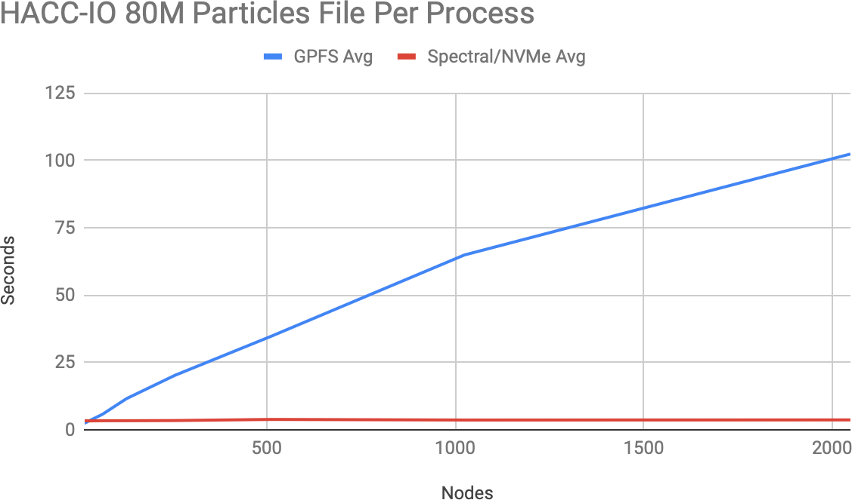
Performance
Measured up to 2048 nodes

Slide 72
Agenda
Summit overview
Summit Scheduler and Job Launch Introduction
  Batch System (LSF)
  Job Launcher (jsrun)
The Summit Programming Environment
  LMOD Environment Modules
  Programming Models (MPI/OpenMP/CUDA)
Summit Burst Buffer
NVIDIA Profilers on Summit

Slide 73
CUDA Vector Addition
#include <stdio.h>
#define N 1048576
global void add_vectors(int *a, int *b, int *c){
int id = blockDim.x * blockIdx.x + threadIdx.x;
if(id < N) c[id] = a[id] + b[id];
}
int main(){
size_t bytes = N*sizeof(int);
int *A = (int*)malloc(bytes);
int *B = (int*)malloc(bytes);
int *C = (int*)malloc(bytes);
int *d_A, *d_B, *d_C;
cudaMalloc(&d_A, bytes); cudaMalloc(&d_B, bytes); cudaMalloc(&d_C, bytes);
for(int i=0; i<N; i++){
A[i] = 1;
B[i] = 2;
}
cudaMemcpy(d_A, A, bytes, cudaMemcpyHostToDevice); cudaMemcpy(d_B, B, bytes, cudaMemcpyHostToDevice);
int thr_per_blk = 256;
int blk_in_grid = ceil( float(N) / thr_per_blk );
add_vectors<<< blk_in_grid, thr_per_blk >>>(d_A, d_B, d_C);
cudaMemcpy(C, d_C, bytes, cudaMemcpyDeviceToHost); free(A);
free(B);
free(C);
cudaFree(d_A);
cudaFree(d_B);
cudaFree(d_C);
return 0;
}

Slide 74
CUDA Vector Addition
#include <stdio.h>
#define N 1048576
global void add_vectors(int *a, int *b, int *c){
int id = blockDim.x * blockIdx.x + threadIdx.x;
if(id < N) c[id] = a[id] + b[id];
}
int main(){
size_t bytes = N*sizeof(int);
int *A = (int*)malloc(bytes);
int *B = (int*)malloc(bytes);
int *C = (int*)malloc(bytes);
int *d_A, *d_B, *d_C;
cudaMalloc(&d_A, bytes); cudaMalloc(&d_B, bytes); cudaMalloc(&d_C, bytes);
for(int i=0; i<N; i++){
A[i] = 1;
B[i] = 2;
}
Vector addition kernel (GPU)
Copy data from CPU to GPU
cudaMemcpy(d_A, A, bytes, cudaMemcpyHostToDevice); cudaMemcpy(d_B, B, bytes, cudaMemcpyHostToDevice);
int thr_per_blk = 256;
int blk_in_grid = ceil( float(N) / thr_per_blk );
add_vectors<<< blk_in_grid, thr_per_blk >>>(d_A, d_B, d_C);
cudaMemcpy(C, d_C, bytes, cudaMemcpyDeviceToHost); free(A);
free(B);
free(C);
cudaFree(d_A);
cudaFree(d_B);
cudaFree(d_C);
return 0;
}
Set configuration parameters and launch kernel
Allocate memory on CPU
Copy data from GPU to CPU
Allocate memory on GPU
Free memory on CPU and GPU
Initialize arrays on CPU

Slide 75
Vector Addition Example
$ cd vector_addition/cuda
$ nvcc vec_add.cu –o run
$ bsub submit.lsf
Invoke the command line profiler
-s: Print summary of profiling results
(default unless -o is used)
-o: Export timeline file
(to be opened later in NVIDIA Visual Profiler)
%h: replace with hostname
${LSB_JOBID} holds the job ID assigned by LSF (NOT specific to NVIDIA profilers)
From submit.lsf:
jsrun -n1 -c1 -g1 -a1 nvprof -s -o vec_add_cuda.${LSB_JOBID}.%h.nvvp ./run

Slide 76

Vector Addition Example
(1) nvprof results – text only
From vec_add_cuda.JOBID:
==174655== Profiling result:
 | Type | Time(%) | Time | Calls | Avg | Min | Max | Name
GPU | activities: | 56.25% | 463.36us | 2 | 231.68us | 229.66us | 233.70us | [CUDA memcpy HtoD]
 |  | 41.59% | 342.56us | 1 | 342.56us | 342.56us | 342.56us | [CUDA memcpy DtoH]
 |  | 2.16% | 17.824us | 1 | 17.824us | 17.824us | 17.824us | add_vectors(int*, int*, | int*)
 | API calls: | 99.35% | 719.78ms | 3 | 239.93ms | 1.1351ms | 717.50ms | cudaMalloc
 |  | 0.23% | 1.6399ms | 96 | 17.082us | 224ns | 670.19us | cuDeviceGetAttribute
 |  | 0.17% | 1.2559ms | 3 | 418.64us | 399.77us | 454.40us | cudaFree
 |  | 0.16% | 1.1646ms | 3 | 388.18us | 303.13us | 550.07us | cudaMemcpy
 |  | 0.06% | 412.85us | 1 | 412.85us | 412.85us | 412.85us | cuDeviceTotalMem
 |  | 0.03% | 182.11us | 1 | 182.11us | 182.11us | 182.11us | cuDeviceGetName
 |  | 0.00% | 32.391us | 1 | 32.391us | 32.391us | 32.391us | cudaLaunchKernel
 |  | 0.00% | 3.8960us | 1 | 3.8960us | 3.8960us | 3.8960us | cuDeviceGetPCIBusId
 |  | 0.00% | 2.2920us | 3 | 764ns | 492ns | 1.1040us | cuDeviceGetCount
 |  | 0.00% | 1.4090us | 2 | 704ns | 423ns | 986ns | cuDeviceGet

Slide 77
Vector Addition Example
(2) Visual Profiler
Transfer the .nvvp file to your local machine to view in NVIDIA Visual Profiler.
From your local system:
$ scp USERNAME@login1.ascent.ccs.ornl.gov:/path/to/file/remote /path/to/desired/location/local

Slide 78


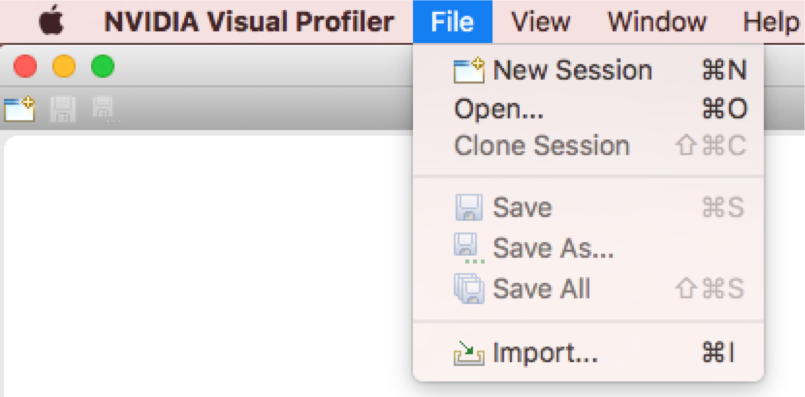
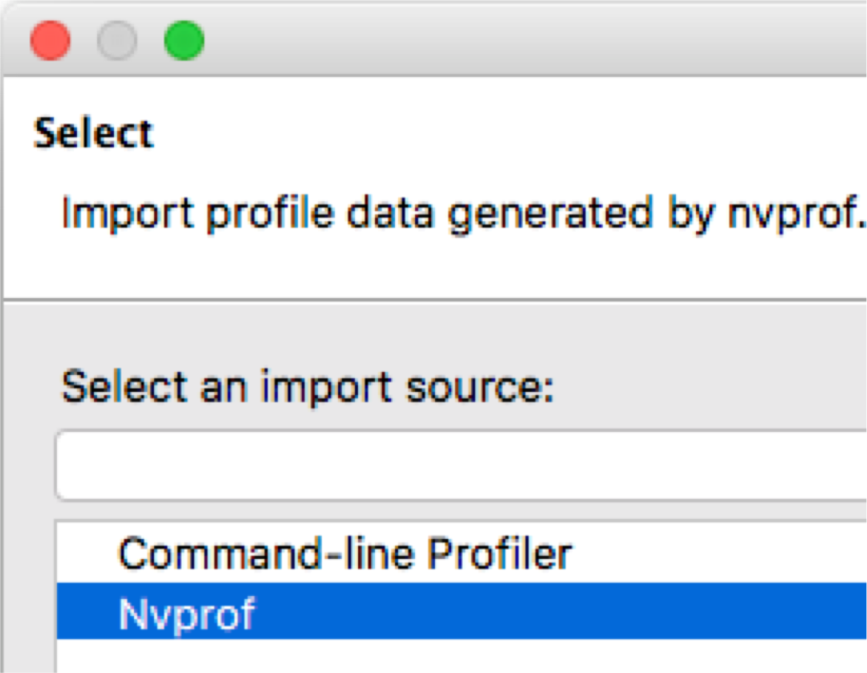
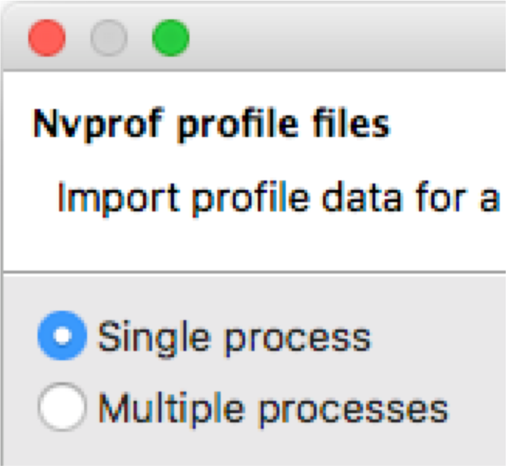
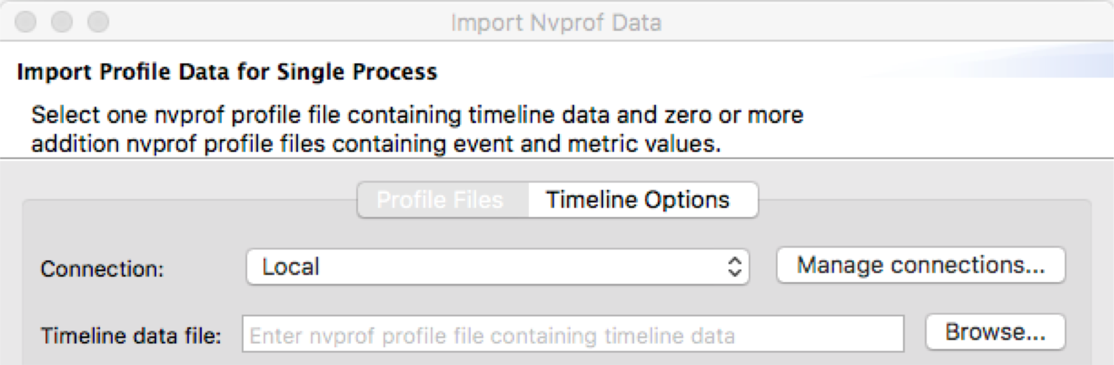
Vector Addition Example (Visual Profiler)
File->Import Select “Nvprof” then “Next >”
3
Select “Single Process” then “Next >”
1 2
4
Click “Browse” next to “Timeline data file” to locate the .nvvp file on your local system, then click “Finish”

Slide 79
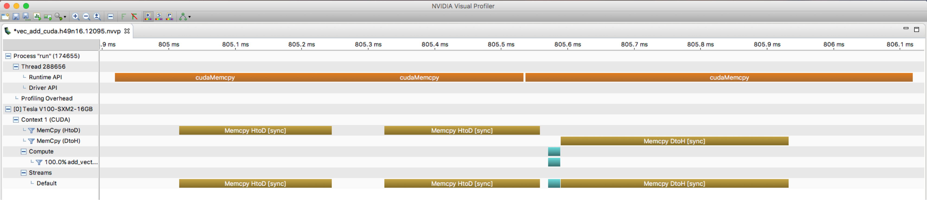


Vector Addition Example (Visual Profiler)
To zoom in on a specific region, hold Ctrl + left-click and drag mouse (Cmd for Mac)
Zoom all the way out
Left-click the timeline and drag mouse to measure specific activities
Data Transfers Kernel Execution
CUDA API activity from CPU process
GPU activity

Slide 80
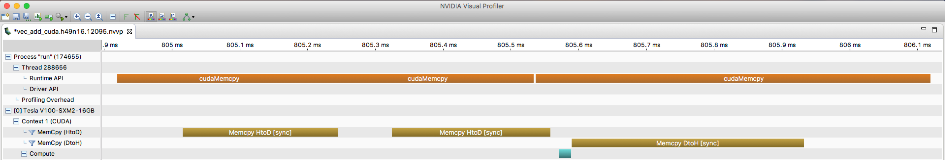
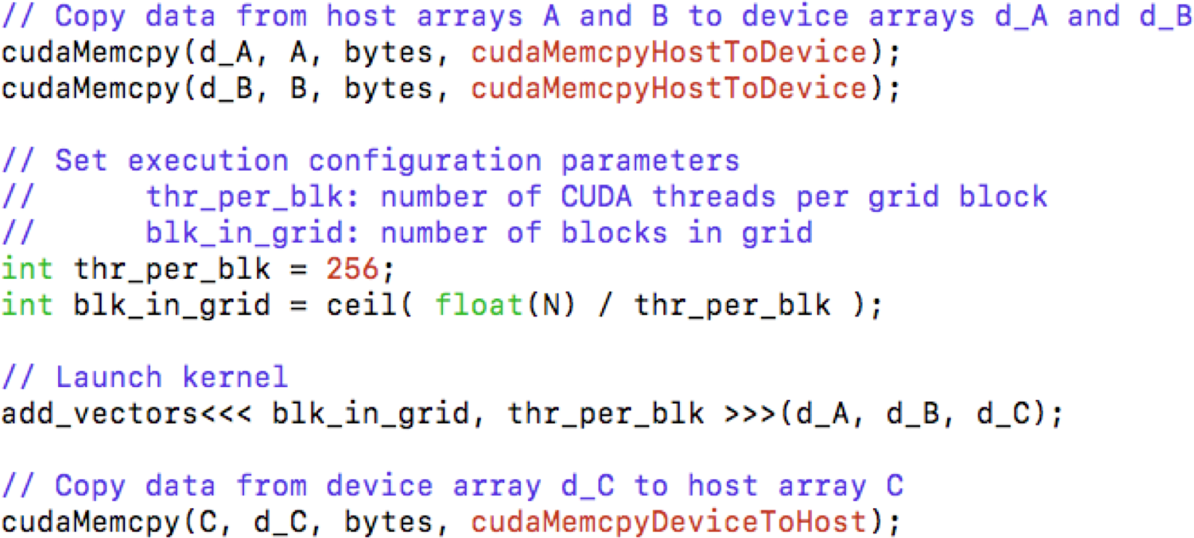
Vector Addition Example (Visual Profiler)
Type | Time(%) | Time | Calls | Avg | Min | Max | Name
GPU activities: | 56.25% | 463.36us | 2 | 231.68us | 229.66us | 233.70us | [CUDA memcpy HtoD]
 | 41.59% | 342.56us | 1 | 342.56us | 342.56us | 342.56us | [CUDA memcpy DtoH]
 | 2.16% | 17.824us | 1 | 17.824us | 17.824us | 17.824us | add_vectors(int*, int*, int*)

Slide 81
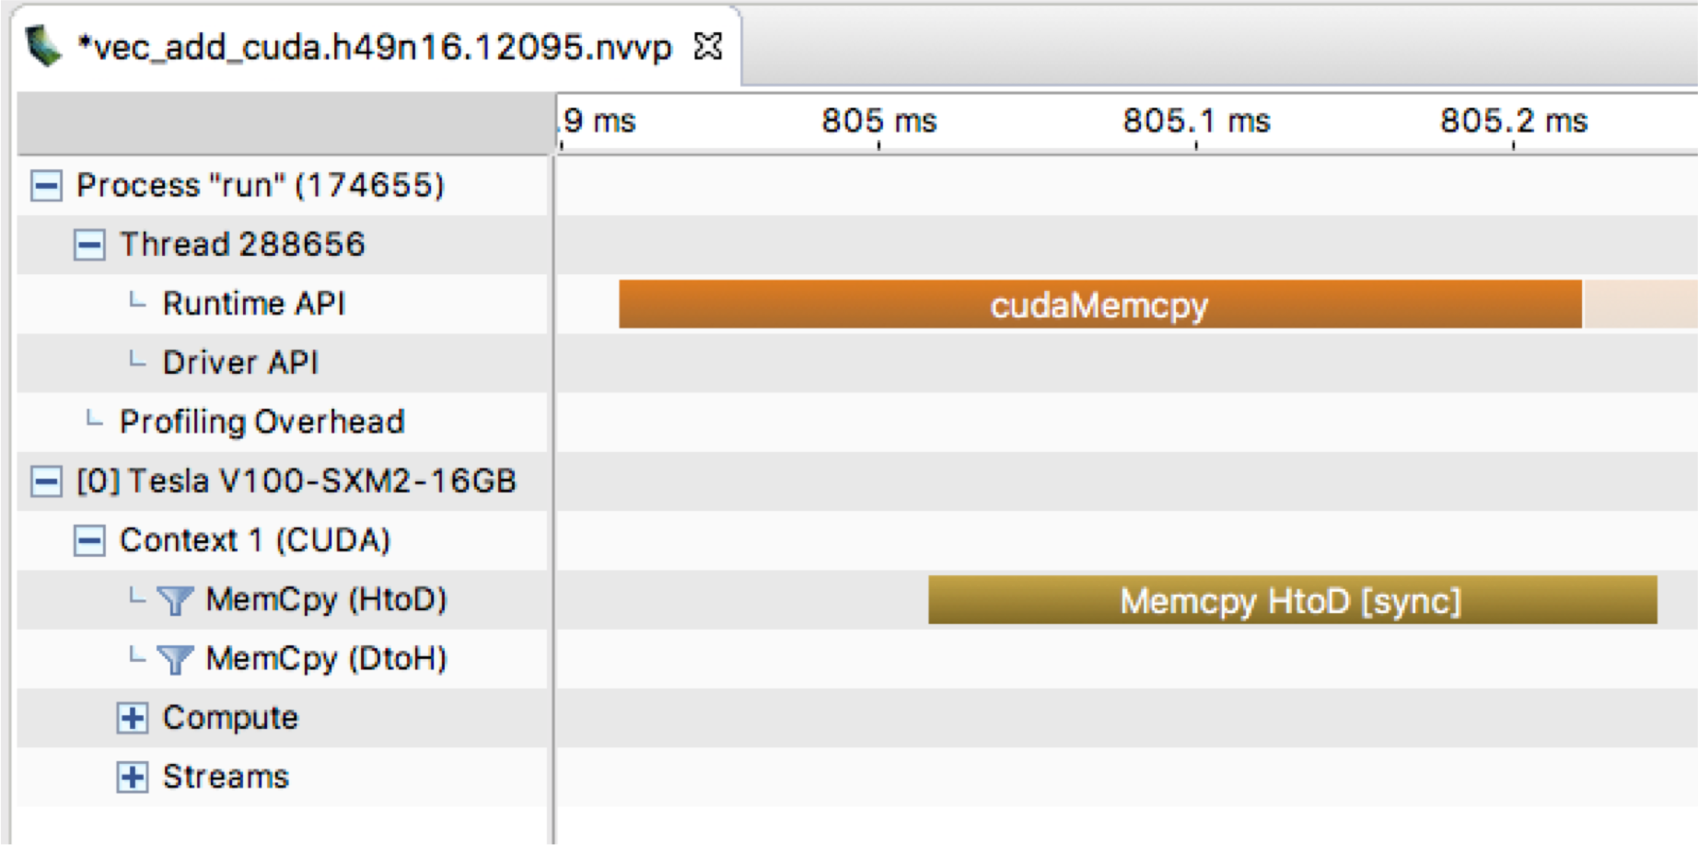

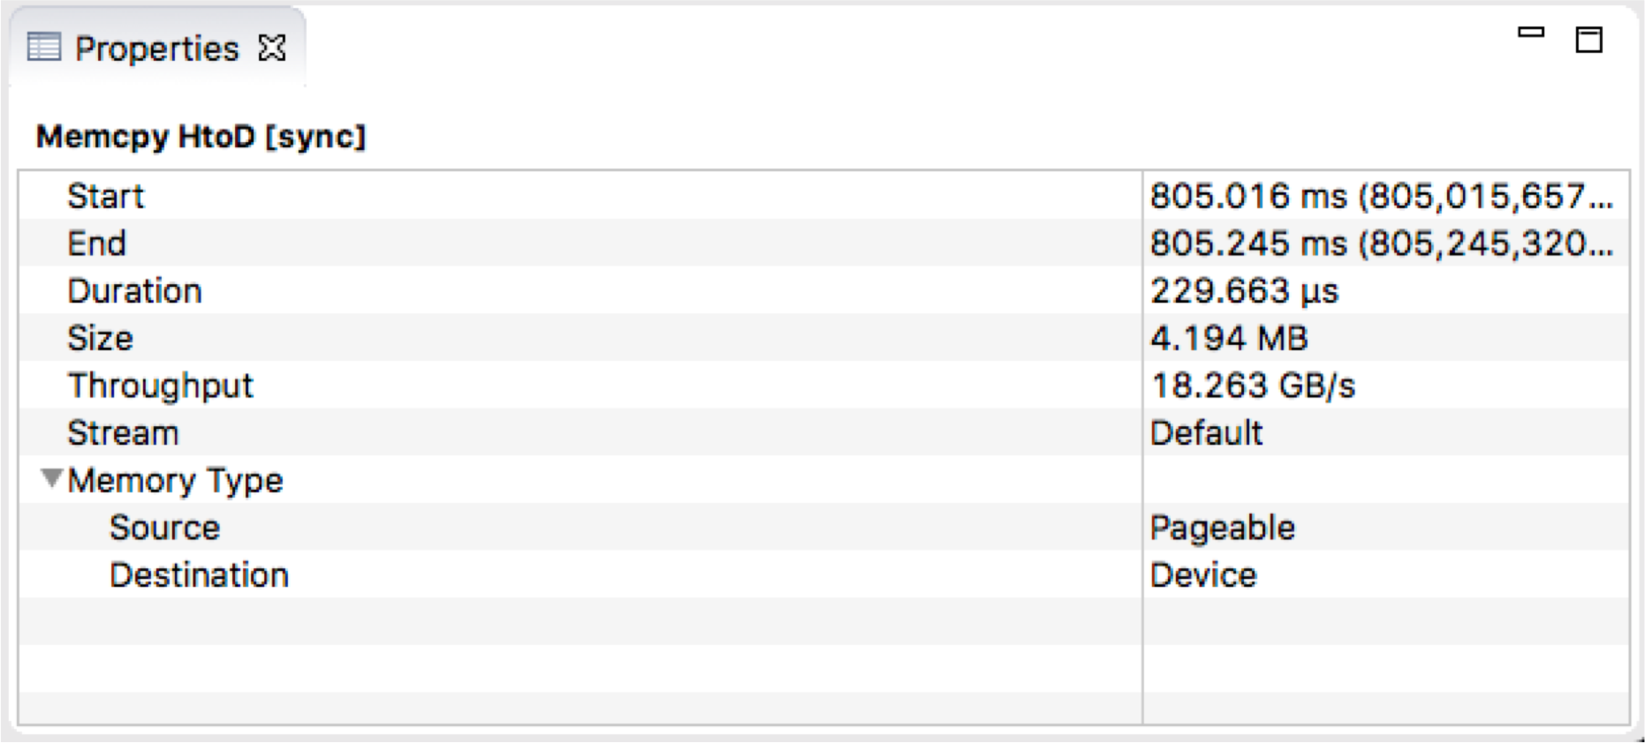
Vector Addition Example (Visual Profiler)
CUDA API Call
Actual Data Transfer
Details about the data transfer

Slide 82
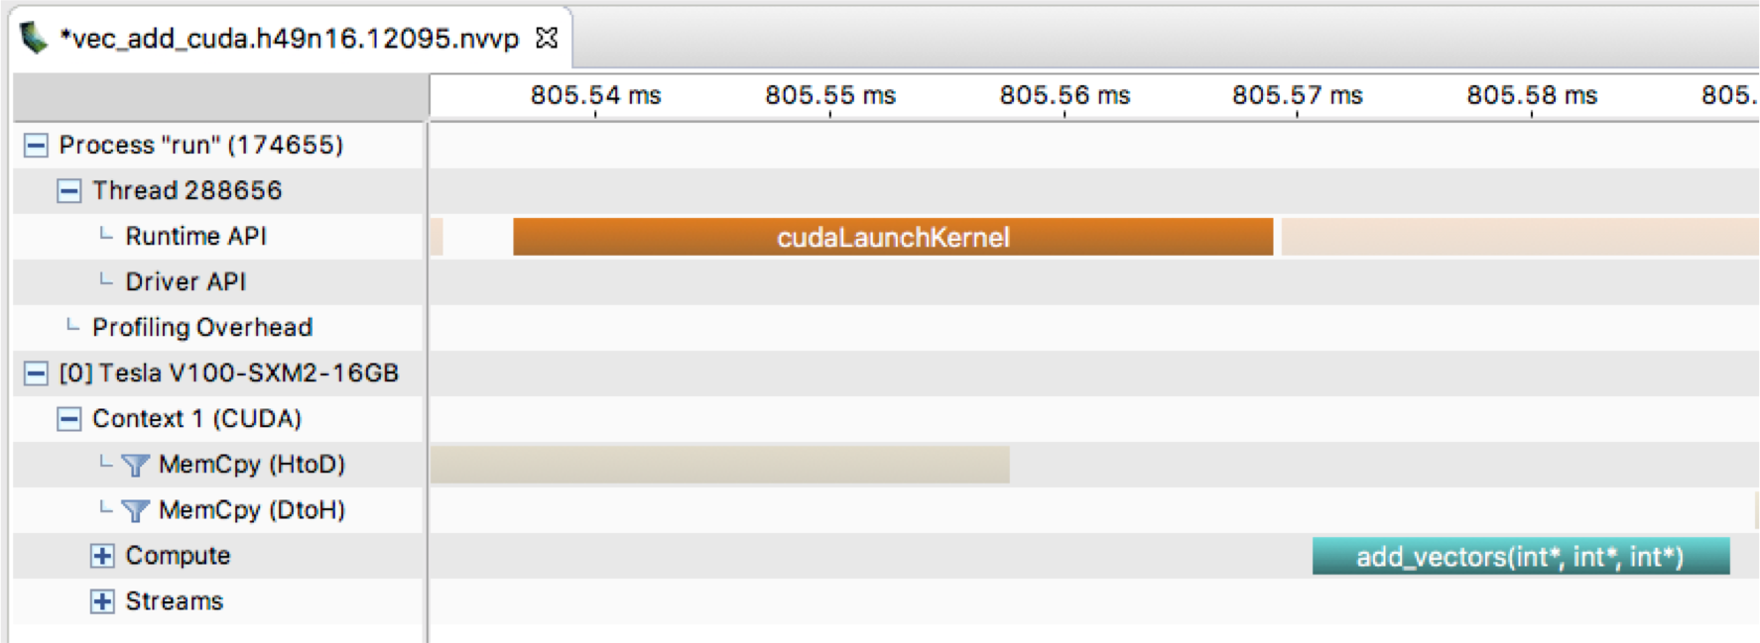
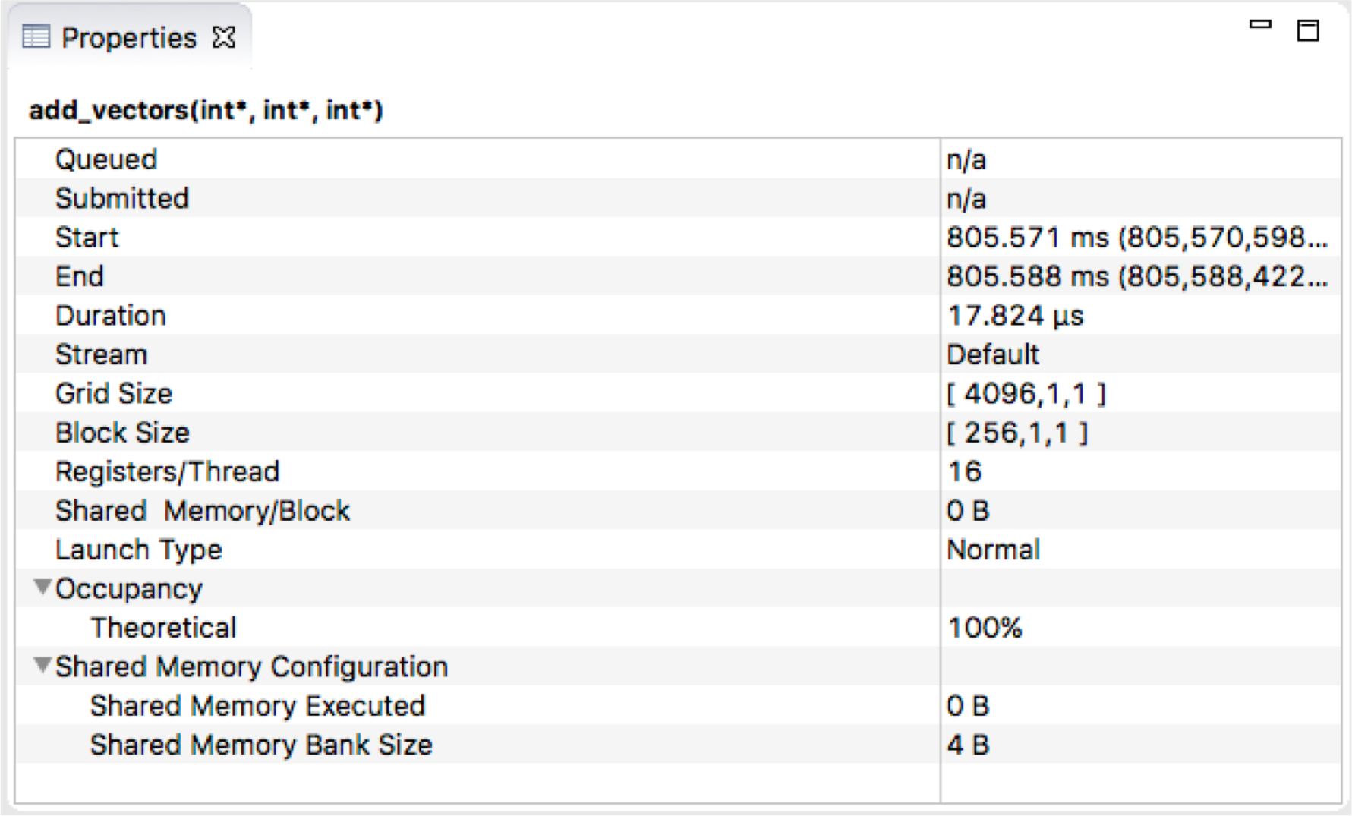
Vector Addition Example (Visual Profiler)
Details about the kernel execution

